Slide 1

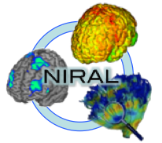
DTIAtlasFiberAnalyzer
Tutorial
Benjamin Yvernault

Slide 2
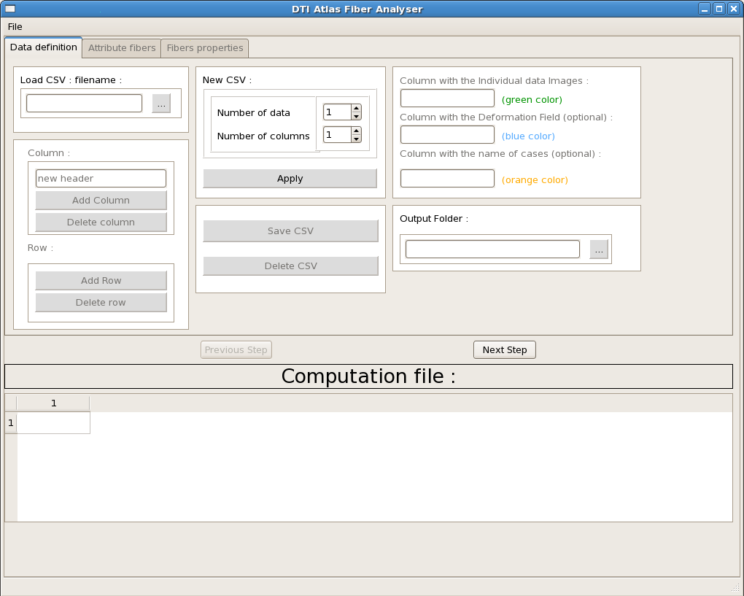
Overview
Introduction
Three Steps
Data Definition
Attribute fibers
Fibers Properties
Command line execution
Output Folder Hierarchy
Parameters File with example

Slide 3
Introduction
Welcome to DTI Atlas Fiber Analyzer tutorial
DTIAtlasFiberAnalyzer is an open-source, friendly user software. It applies an atlas fibers to all datasets, extracts the Fiber profiles and gathers all the information.
You can call it with or without a graphical user interface.

Slide 4
Three Steps = three tabs
Create or Download CSV File
Select Fibers in Atlas and attribute them to all the dataset
Extract Profiles information from fibers

Slide 5
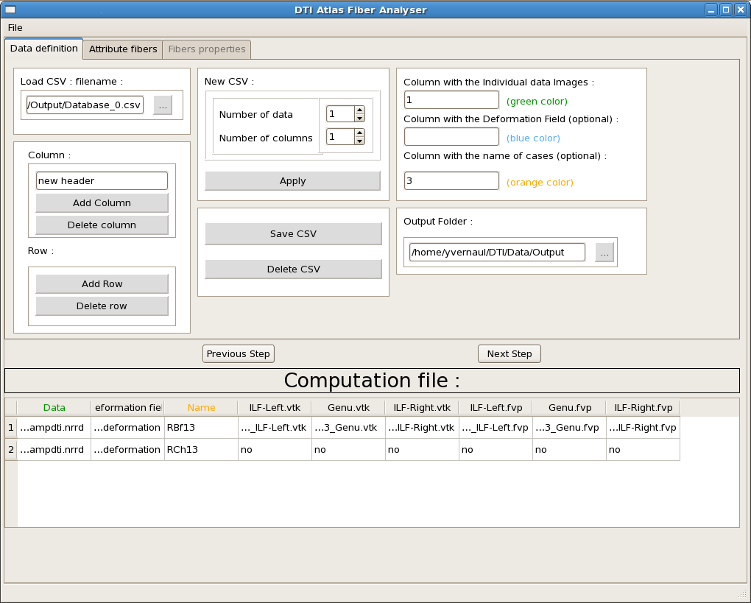
Data Definition
Define CSV File :
    Create
    Load
Select Column where there is the path of data, deformation field and the name of data.
Give Output Folder.
Add/Delete Column and Row if you need.

Slide 6
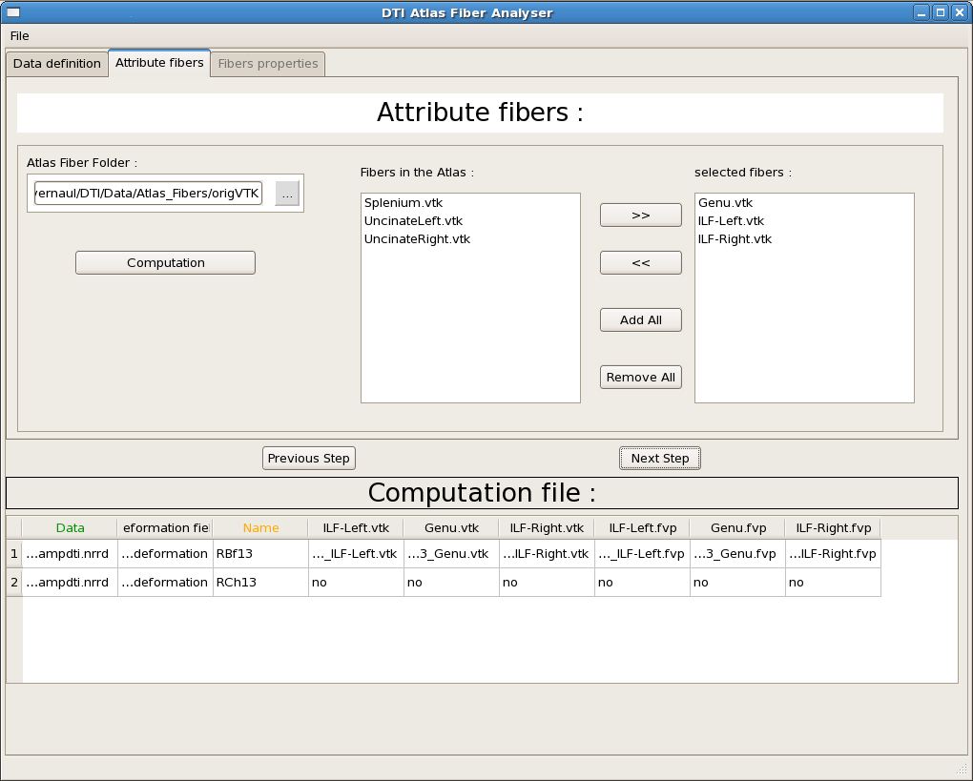
Attribute fibers
Give Atlas Fiber Folder
Choose which Fibers you want to use
Click on computation

Slide 7
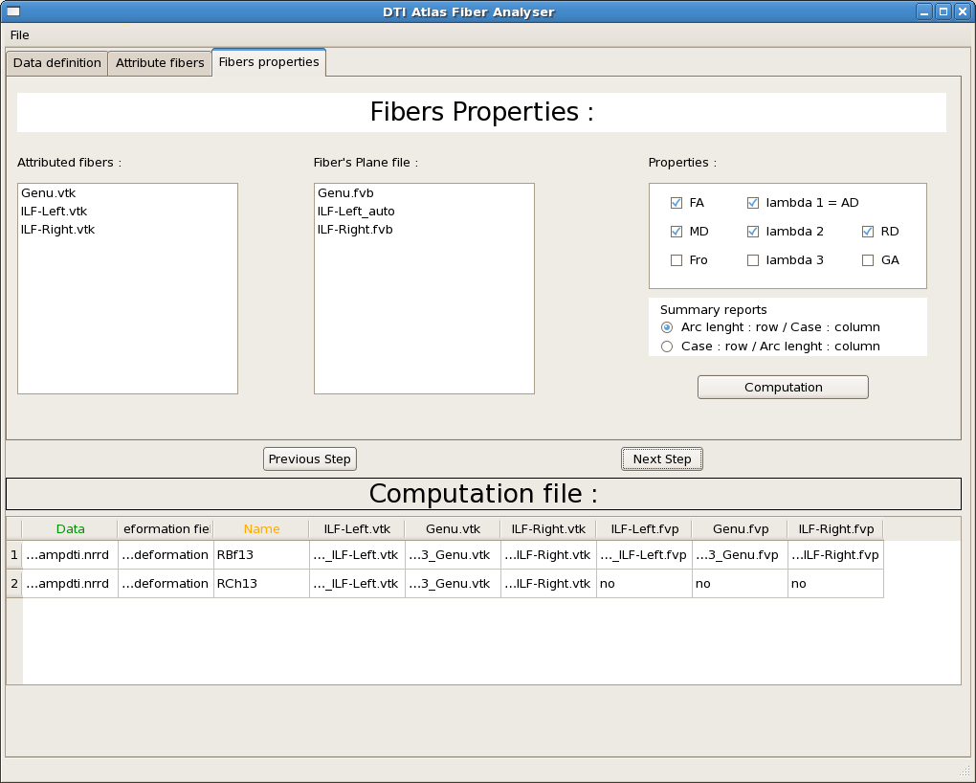
Fibers Properties
Choose properties you want to analyze
Choose where you want Case and Arc length
Click on Computation : it will extract the fibers properties and gather them in spreadsheets.

Slide 8
Command line execution
Options :
    -L or --loadCSV : use it to give a CSV File name to load
    -P or --parametersfile : use this option to give the name of the parameters file
    --nogui:use this option to call DTIAtlasFiberAnalyzer by command line.
    --debug : for computer-scientist

Slide 9
Output Folder Hierarchy
Output Folder
Cases
CASE1
CASE2
FiberProfiles
Fiber1
CSV File autosave
CSV parameters text file autosave
Fiber1.vtk
Fiber2.vtk
Fiber1.fvp
Fiber2
Property1.csv
Property2.csv

Slide 10
Parameters File
You can open parameters text file and load them :
  Save and Open from the Menu File
  Save automatically after each computation

Slide 11
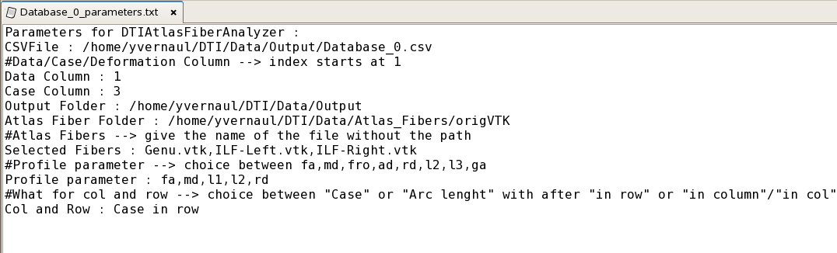
Parameters File example
The parameters file needs specials keys. Use the option help to see how to write a parameters file. This is an example :

Slide 12
Conclusion
DTIAtlasFiberAnalyzer is an easy way to apply an atlas fibers to all datasets and to extract profiles information.
Thanks to this tutorial, you are now ready to use DTIAtlasFiberAnalyzer on your own dataset.

