Slide 1
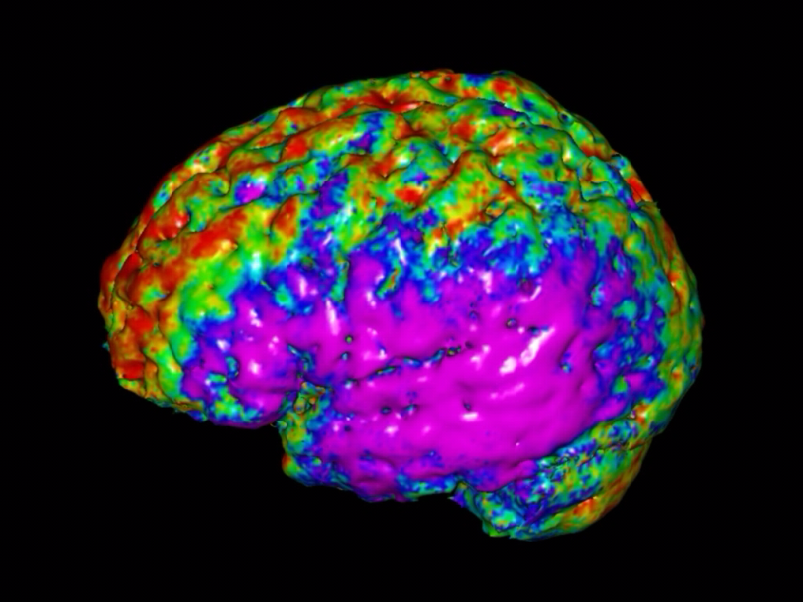
New Features Added to
Our DTI Package
XU, Dongrong Ph.D.
Columbia University
New York State Psychiatric Institute
Support: 1R03EB008235-01A1
June 18, 2009 HBM

Slide 2
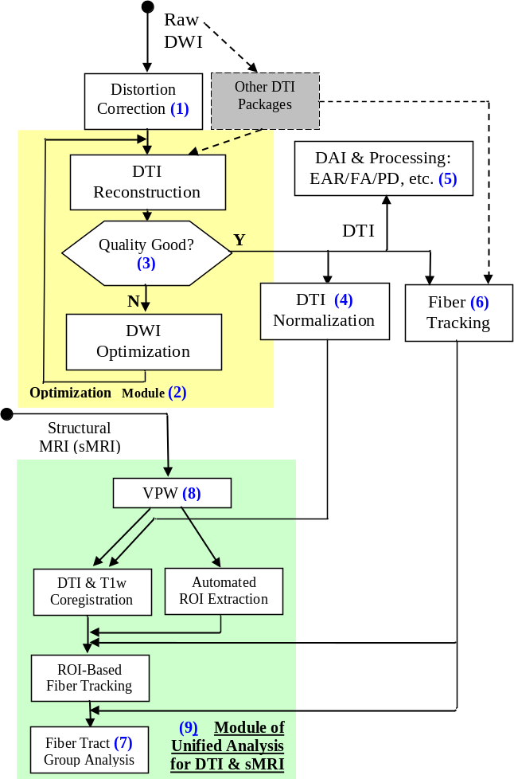
  Fig. 0. An Overview of the Software Package Dashed lines represent routes of possible data exchange with other available DTI packages. Whereas the functions corresponding to the description are marked in numbers in parenthesis, functions in the 2 color blocks constitute 2 compound tools.
Improvements
Warping Algorithm
Optimized Tensor
Estimation

Slide 3
Seamless Warping of DTI

Slide 4
Tensors must be reoriented
Original Fiber
Deformed fiber

Slide 5
Spatial transformation should not be
directly applied to the tensors
Wrong
Correct
Deformed Fiber
Original Fiber
Deformed fiber

Slide 6
Tensor’s original orientation is important
Shear Force

Slide 7
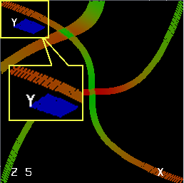
Template Space
Forward mapping
Original Space
Backward mapping
P1
Grid locations: no interpolation is needed
P2
Locations where interpolation is required
A potential seam in forward mapping procedures
A location of potential artifact in forward mapping procedures
Forward and Backward Mappings In forward mapping procedures, seams (depicted in the template space with a red cross) will occur when pixels in the original imaging space (black dots) are distributed only to their immediately neighboring grid points in the template space (orange dots). Consequently, artifacts (an example is represented by a blue dot in the figure) will occur at locations of a partial seam (e.g., location P1 generates a seam at the grid point of the blue dot but location P2 does not). In contrast, if backward mapping is used, every discrete location (voxel) in the template space will receive its corresponding value from a point in the original imaging space. However, this description of backward mapping applies only to scalar images. In DTI, backward mapping alone is insufficient because of the additional need to reorient the tensor

Slide 8
Our New Warping Frame
Issue 4
DTI Normalization
+
Estimate
Optimized
Neighborhood
Calculate
Correspondence
Bi-directional
Correspondence
(Bijection)
Tensor
Relocation
Estimate
True
Orientation
PDF Vector
Resample
Procrustean
Estimation
Tensor
Reorientation
Issues 1,2,3
Reorientation by Procrustean Estimation in an optimized neighborhood, based on estimated PDF(•)

Slide 9
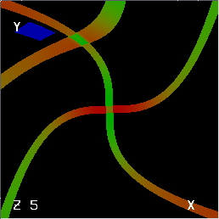
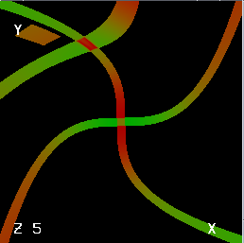
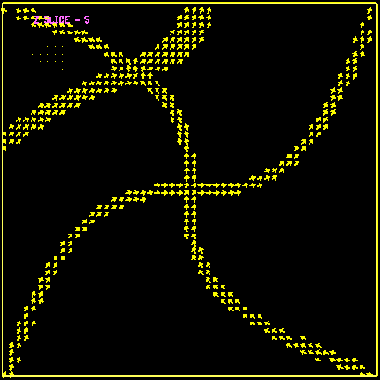
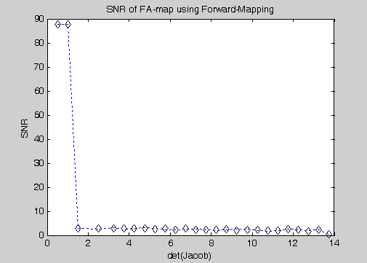
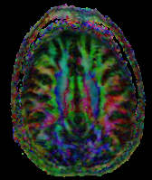
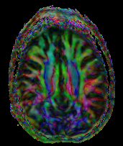
Seamless DTI Warping
Simulated
Dataset
Real
Dataset
Forward Warping
Seamless Warping
Accuracy Improvement of Realigning Tensor Orientation:
25.96%(within fiber); 9.77%(fiber boundary)
in comparison with the non-seamless DTI Warping

Slide 10
Optimized Tensor Estimation

Slide 11
Algorithm
- Smallest combination of DWI along gradient directions with the smallest Condition Number, usually evenly distributed in the 3D space, and optimal J, an index for better image quality re FA & positive definiteness of the tensors
- Expand the combination until the indices become worse

Slide 12
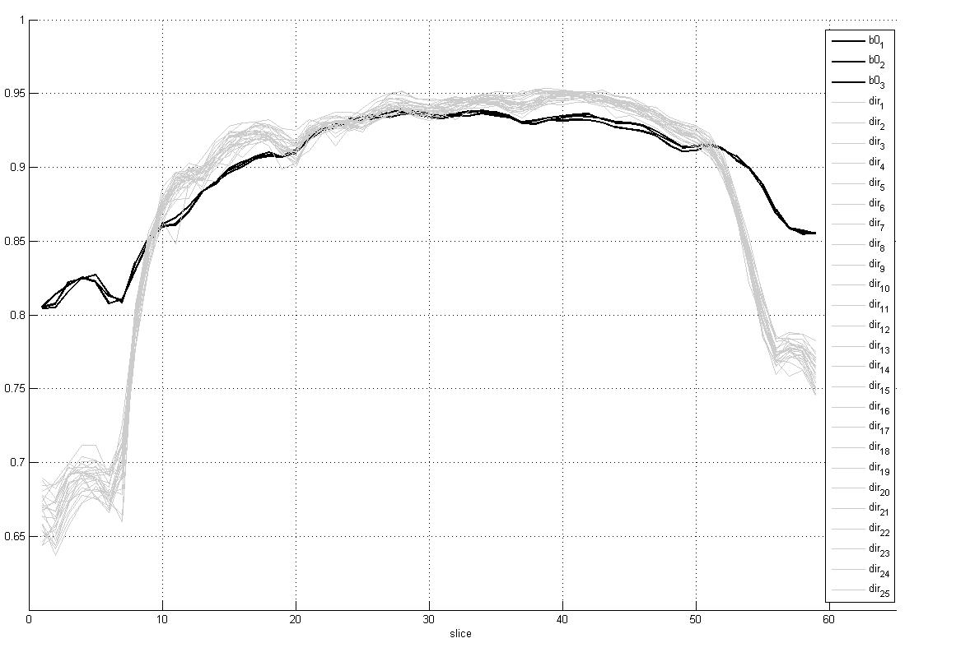
Newly Added:
Correlation between DWI & baseline images
Figure 2. (a) Correlation of a relative good dataset between individual DWI data and reference baseline data.

Slide 13
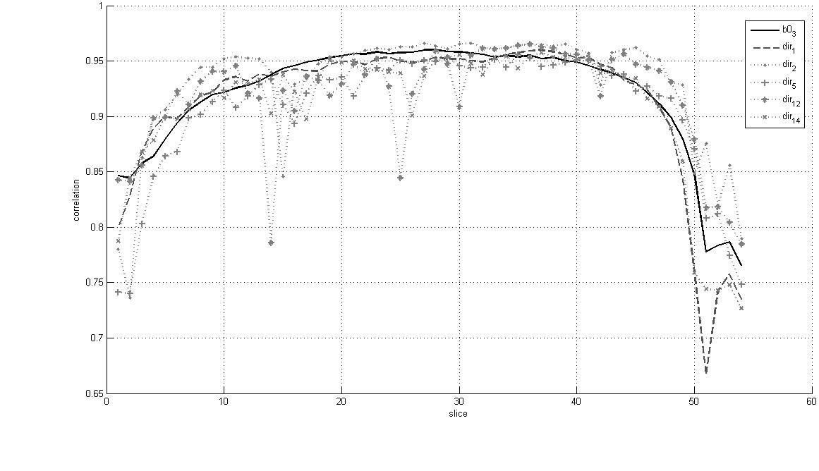
Slice to be excluded
Figure 2. (b) Correlation of a dataset that contain outliers on some image slices.

Slide 14
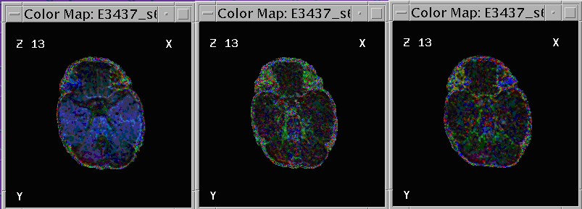
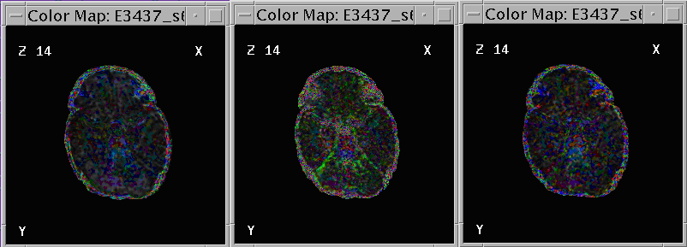
A comparison between the results of our method and the manual work of human experts.
No Optimization Our Method Manual Optimization

Slide 15
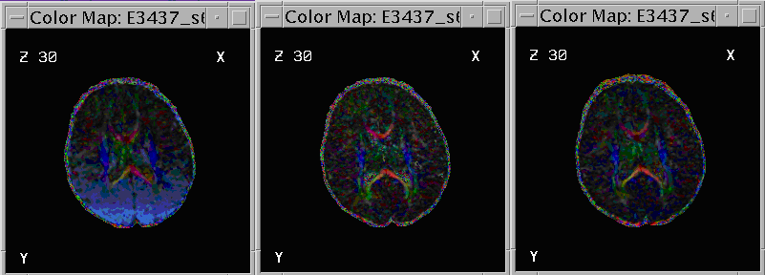
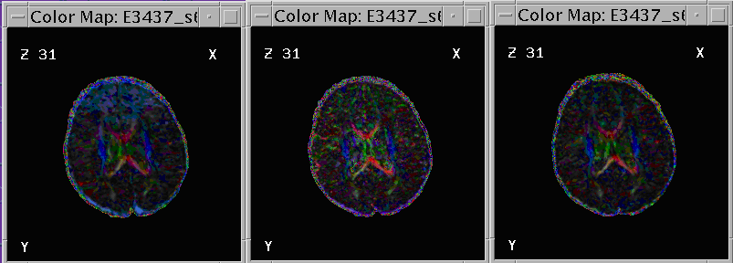
Figure 3. Left: DT image without optimization. Middle: Result of our proposed method. Right: Manual result by human technicians.

Slide 16
Thank you

