Slide 1


Integrating GUI and Command Line Tool Design and Development
Xenios Papademetris
Departments of Diagnostic Radiology
and Biomedical Engineering
Yale University School of Medicine

Slide 2
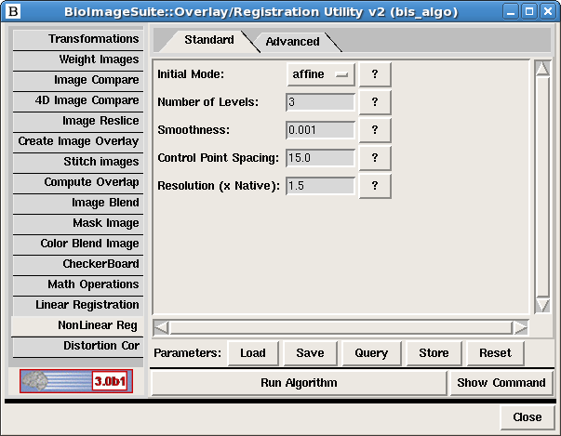
The command line won’t die …
… even Macs have it now.
bis_nonlinearintensityregister.tcl -spacing 12 -initialmode rigid -inp MNI_T1_1mm_stripped.nii.gz –inp2 Test_stripped.hdr

Slide 3
Talk Outline
Some background: BioImage Suite
Problems with Supporting Multiple Interfaces
The BioImage Suite 3 Object Oriented Algorithm Design
Parameter Handling

Slide 4
History
Started life as a Cardiac Image Analysis Tool (1996)
Expanded into neuroimaging for epilepsy (2001)
Since then other applications in diabetes/molecular imaging/tissue engineering
Anatomical/fMRI/DTI/Interactive Segmentation/Data Assembly etc.
First public release January 2007 (2.0)
Current version 2.6.1 (stable) 3.0beta 1(testing)

Slide 5
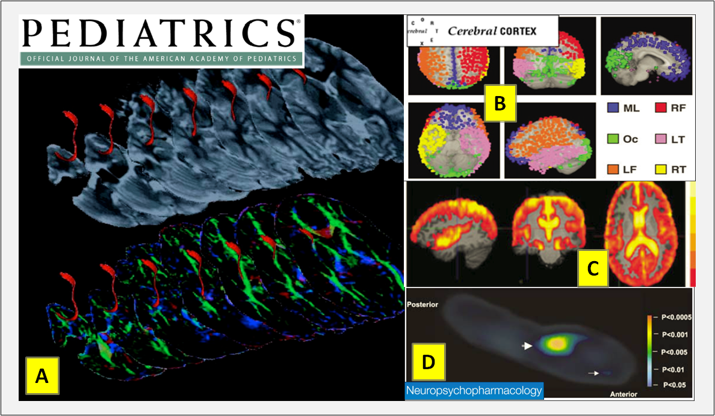
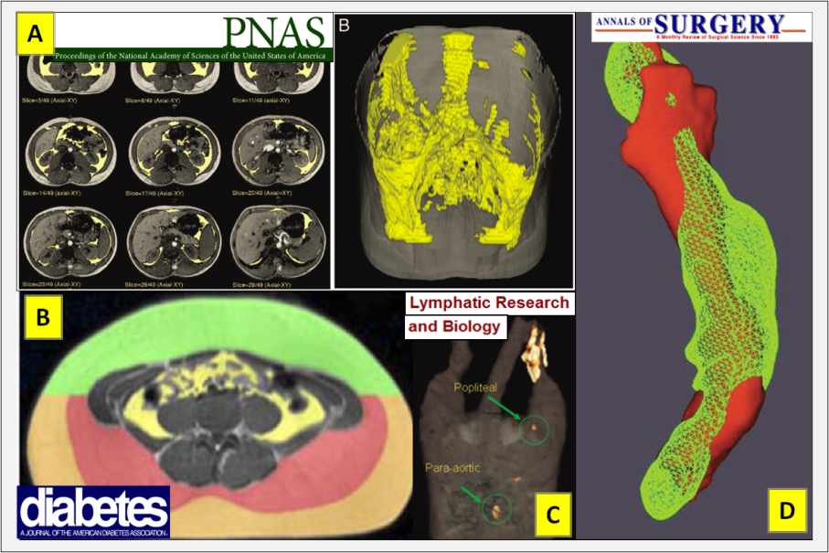
Used for Neuro and Non-Neuro Applications

Slide 6
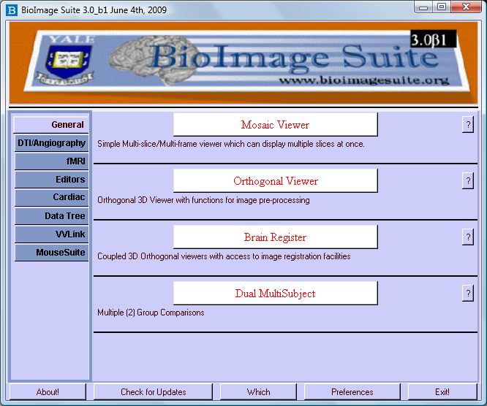
Design Philosophy
Multiplatform Open Source
Developed in a combination of Tcl and C++
Uses a lot of VTK and a little ITK
Not a single application but a set of components which are grouped to form customized applications

Slide 7
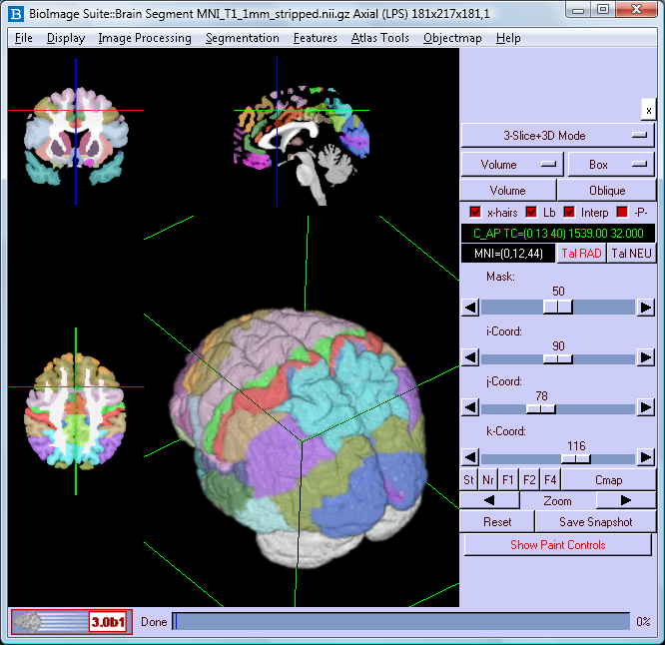
Example Application: Interactive 3D Editor
On Slice + 3D Rendering
Embedded Talairach/MNI coordinates (if neuro)
Custom Broadmann Atlas

Slide 8
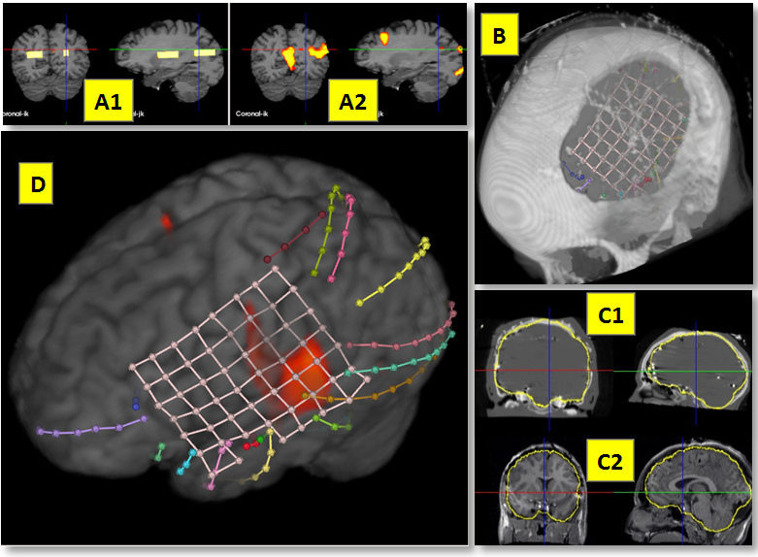
Multimodal Data Assembly

Slide 9
Talk Outline
Some background: BioImage Suite
Problems with Supporting Multiple Interfaces
The BioImage Suite 3 Object Oriented Algorithm Design
Databases?

Slide 10
Interfaces
Graphical User Interfaces
Command Line
Easy to use (nominally)
Hide some of the complexity of the program from the user
But difficult/painful for repetitive tasks
Difficult to test
Harder to use
Often provide access to more functionality
Enable integration with other software & batch jobs
Easier to test

Slide 11
User’s Perspective
Full-Time
  Naive users – can push buttons
  Experienced Users – can also call things on command line, often able to do some scripting
Mostly Full-time
  Power users – can do all of the above and mix and match different applications
Part-time
  Part-time users – mostly use other software but need something in “yours”
  Command-line is often key here to play with others

Slide 12
Programmer’s Perspective
Interfaces for command line and GUI are different
  Often an algorithm is available in only one “mode”
Different code introduces potential (reality) of some divergence in performance
  Slightly different defaults
  Bug fixes do not propagate from one to other
  Becomes more critical as number of algorithms increases
Testing
  Command line testing is easy
  GUI Code testing is more painful

Slide 13
Talk Outline
Some background: BioImage Suite
Problems with Supporting Multiple Interfaces
The BioImage Suite 3 Object Oriented Algorithm Design
Parameter Handling

Slide 14
Design Goals of the Object-Oriented Algorithm Framework
All algorithms should be accesible/have exactly the same whether called from GUI or command-line
  Parameter setting/management code should be identical
  Execution code should be identical
Provide methodology for rational automatic GUI generation to simplify development
Provide automatic command-line parsing module
Database integration for storing/invoking settings

Slide 15
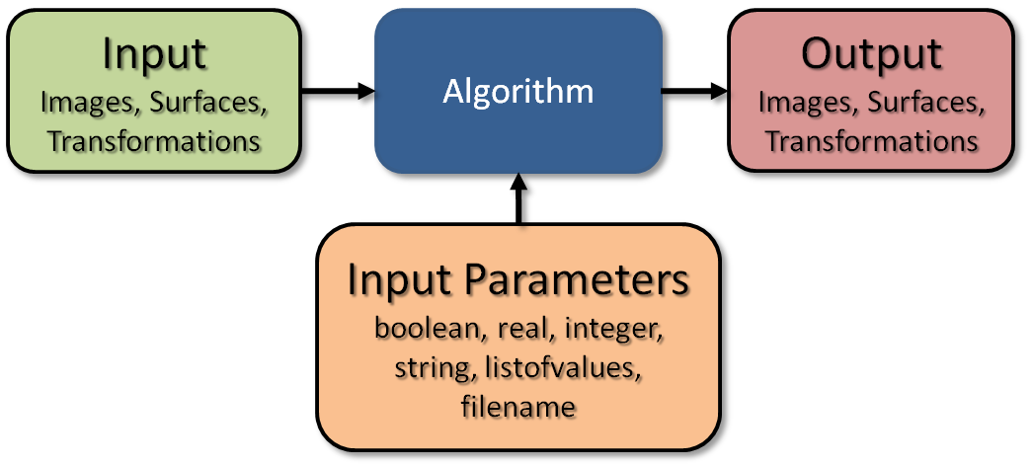
Big Picture
Object-oriented algorithm framework with key functionality in parent classes
  Commandline parsing and automatic GUI generation

Slide 16
Key Concepts
Formal specification of inputs, parameters and outputs
  Name, description, type, help text, importance (e.g. advanced, standard, optional), allowed range, default value, hints about what the GUI should be
This is used to create
  Manual page
  Command line parsing
  Automatic GUI Generation
Interfaces are “buffered” from execution code

Slide 17
Implementation
Two key methods
  Initialize
    Formal specification
  Execute
    Invoked by the interface to run the algorithm
Parameter/GUI Management is handled at the parent class level

Slide 18
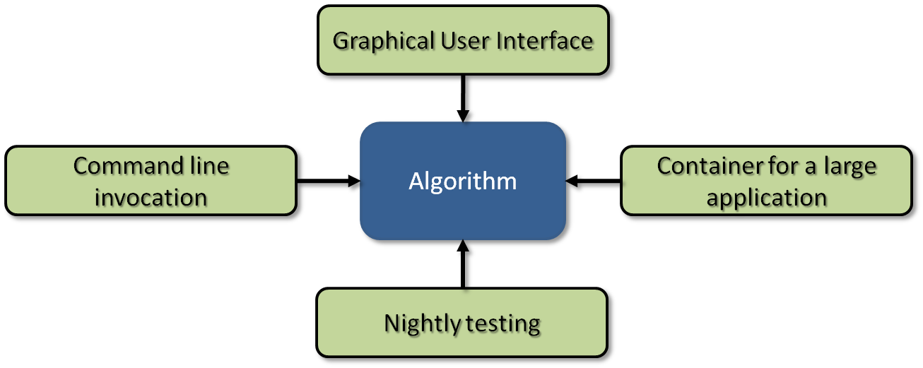
Algorithm Invocation Modes

Slide 19
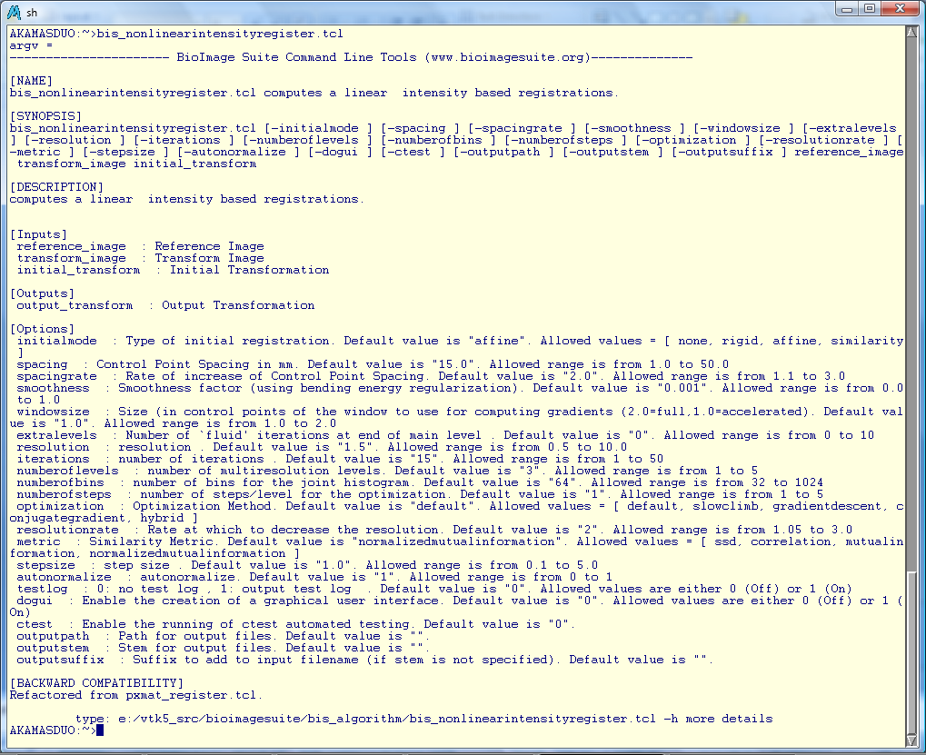
Command Line Version I
bis_nonlinearintensityregister.tcl -spacing 12 -initialmode rigid -inp MNI_T1_1mm_stripped.nii.gz –inp2 Test_stripped.hdr

Slide 20
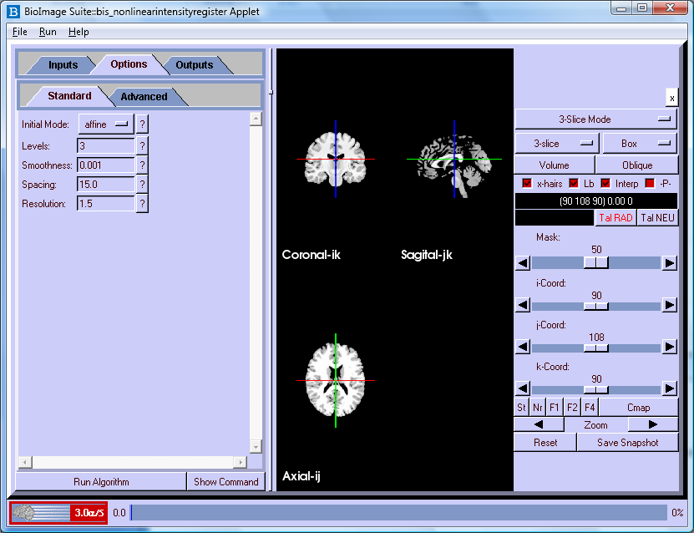
Command Line Applet (-dogui 1)

Slide 21
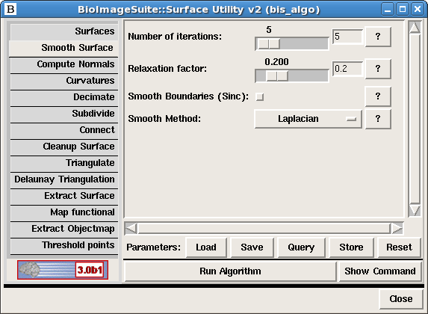
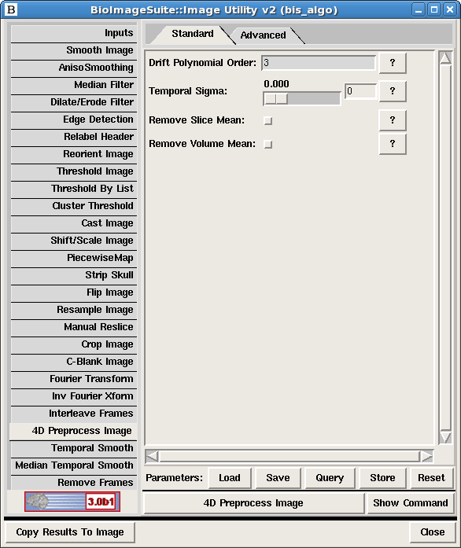
Toolboxes
(B) Surface
Processing
Toolbox
(A) Image
Processing
Toolbox
(C) Overlay/
Registration
Toolbox

Slide 22
Talk Outline
Some background: BioImage Suite
The user is (almost) always right
Problems with Supporting Multiple Interfaces
The BioImage Suite 3 Object Oriented Algorithm Design
Parameter Handling

Slide 23
Parameters
Expert users generate -> beginners use
Study reproducibility
Standardization

Slide 24
Parameter Handling
Two options
  File – this is simply the command line for the algorithm
    E.g.
    #bis_algorithm parameter file
    bis_labelregister.tcl -resolutionrate 2 -numberoflevels 1 -numberofbins 64 -iterations 15 -resolution 1.0 -metric NMI -numberofsteps 3 -spacingrate 2.0 -combinemetric Median -autonormalize 0 -smoothness 0 -windowsize 1.0 -spacing 20 -stepsize 4.0 -optimization default -extralevels 0 -useinitial 0

Slide 25
Parameter Handling II
Sqlite database file
  All Options in BioImage Suite are stored in a configuration file (.bioimagesuite3)
Algorithm Options stored in a table in this
GUI to Query/Store

Slide 26
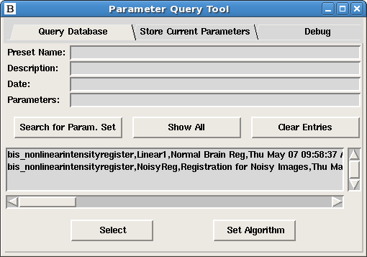
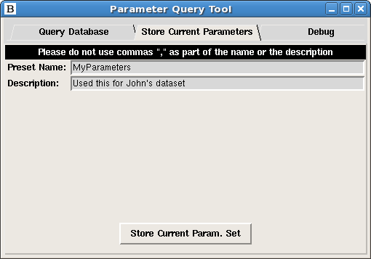
Query Parameters

Slide 27
Parameters on command line
Invoke algorithm using
  bis_linearregister.tcl –pset a.param
  Or
  bis_linearregister.tcl –pset MyParameters
First look for a file of that name, else query database.
User creates parameter set on the GUI and invokes on the command line.

Slide 28
Bonus: Testing
This setup integrates nicely with our CMake/CTest environment
Function in parent class to run regression tests

Slide 29
Conclusions
Supporting multiple interfaces needs to be an intentional process
Algorithm access is not enough
  Parameter settings must translate
  Synchronization between multiple interfaces is a problem
Our Solution was to design a framework that can handle both at the same time
  Goal: Everything accessible both on GUI and CommandLine
Bonus features: Parameter handling and ease of testing

Slide 30
Acknowldgments
Image Analysis James Duncan, Ph. D. Lawrence Staib, Ph. D. Alark Joshi, Ph.D. Yifeng Jiang, Ph. D. BioImage Suite Team Dustin Scheinost Isabella Murphy Hirohito Okuda Marcello DiStasio Thomas Teisseyre MRI/MRS Imaging Todd Constable, Ph. D. Fahmeed Hyder, Ph. D. Cardiology Albert Sinusas, M.D. | Neurosurgery Dennis Spencer, M.D. Kenneth Vives, M.D. Psychiatry Hilary Blumberg, M.D. Psychology Jeremy Gray, Ph. D. Surgery Chris Breuer, M.D. Matt Brennan, M.D. Endocrinology Gerald Shulman, M.D. Ph.D. Kitt Petersen, M.D. Sonia Caprio M.D.

Slide 31
Acknowldgments
NIH/NIBIB: R01EB006494

Slide 32
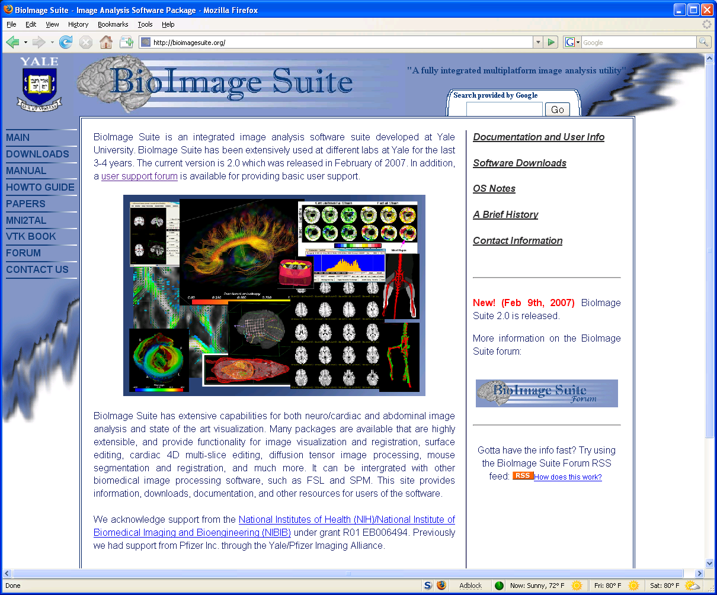
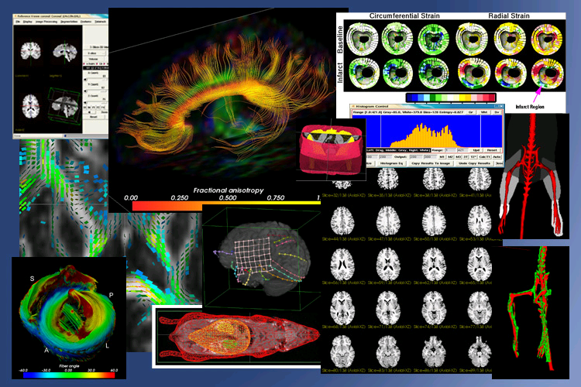
Available at: www.bioimagesuite.org

Slide 33
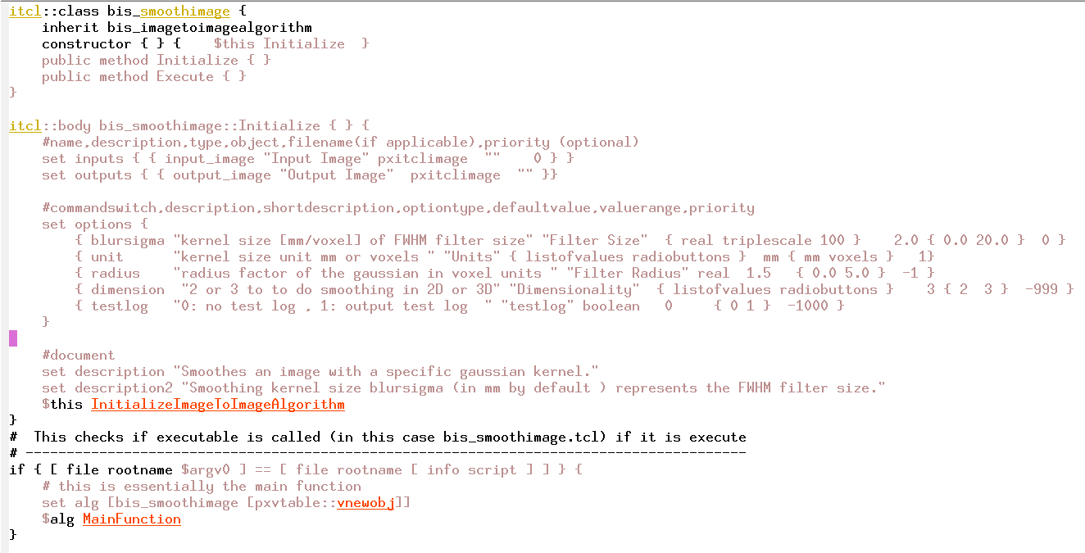
A quick example

