Slide 1


Neoseg Pipeline 1.0
User Tutorial
Marie Cherel, François Budin, Martin Styner
NIRAL website: http://www.med.unc.edu/psych/research/niral

Slide 2

1. Presentation
1.1. Principle
NeosegPipeline is a tool to segment automatically neonate brain MRI using a subject-specific atlas.
This subject-specific atlas is generated based on:
An atlas population : set of cases with a T1, a T2 and a segmentation
Some diffusion information of the subject to segment
This atlas is then given as a input of a single atlas segmentation method called Neoseg

Slide 3
1. Presentation
1.1. Principle
NeosegPipeline writes Python scripts and then run them
This approach allows to:
Keep a trace of what have been done
Eventually run them again with the exact same parameters

Slide 4
1. Presentation
1.2. Links
NeosegPipeline is a free and open-source project
The executable, the documentation and all other information related to the project can be found on its NITRC page:
http://www.nitrc.org/projects/neosegpipeline/
The source code of the project is available on Github:
https://github.com/NIRALUser
A tutorial video on how to use the tool can be found on youtube:
https://www.youtube.com/watch?v=yTr3NJZaMos
A multi-subject brain atlas can be downloaded from here:
http://www.nitrc.org/projects/unc_brain_atlas/

Slide 5
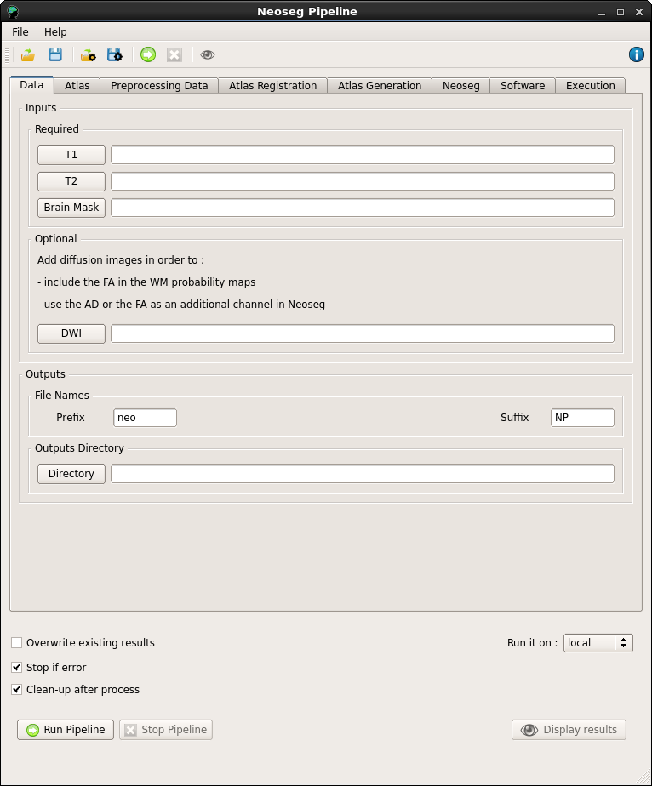
2. Interface
2.1. Presentation
The Graphical User Interface (GUI) is composed of:
1 menu
1 toolbar
8 tabs
1 computation area

Slide 6
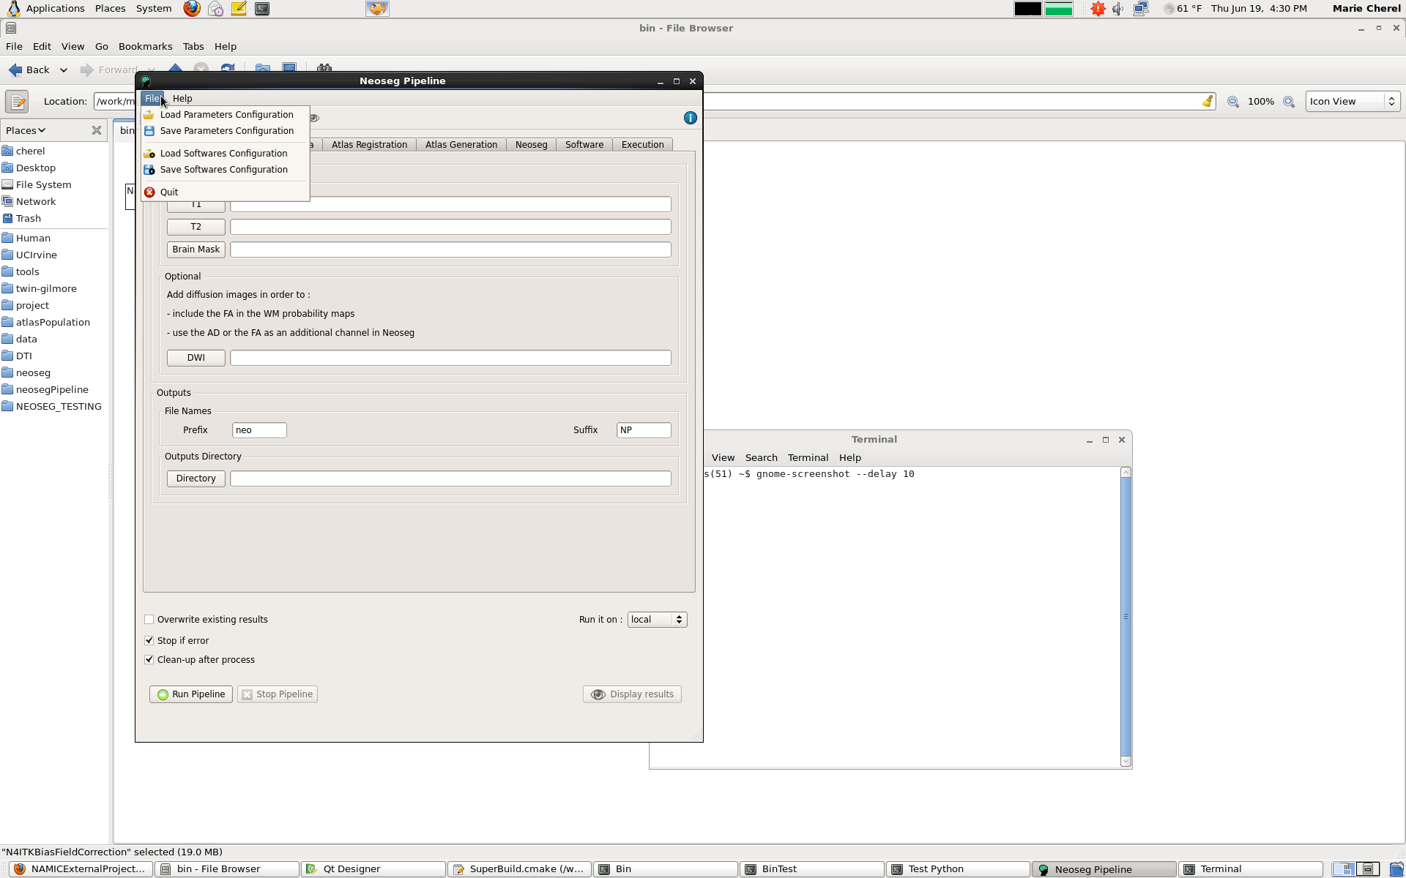
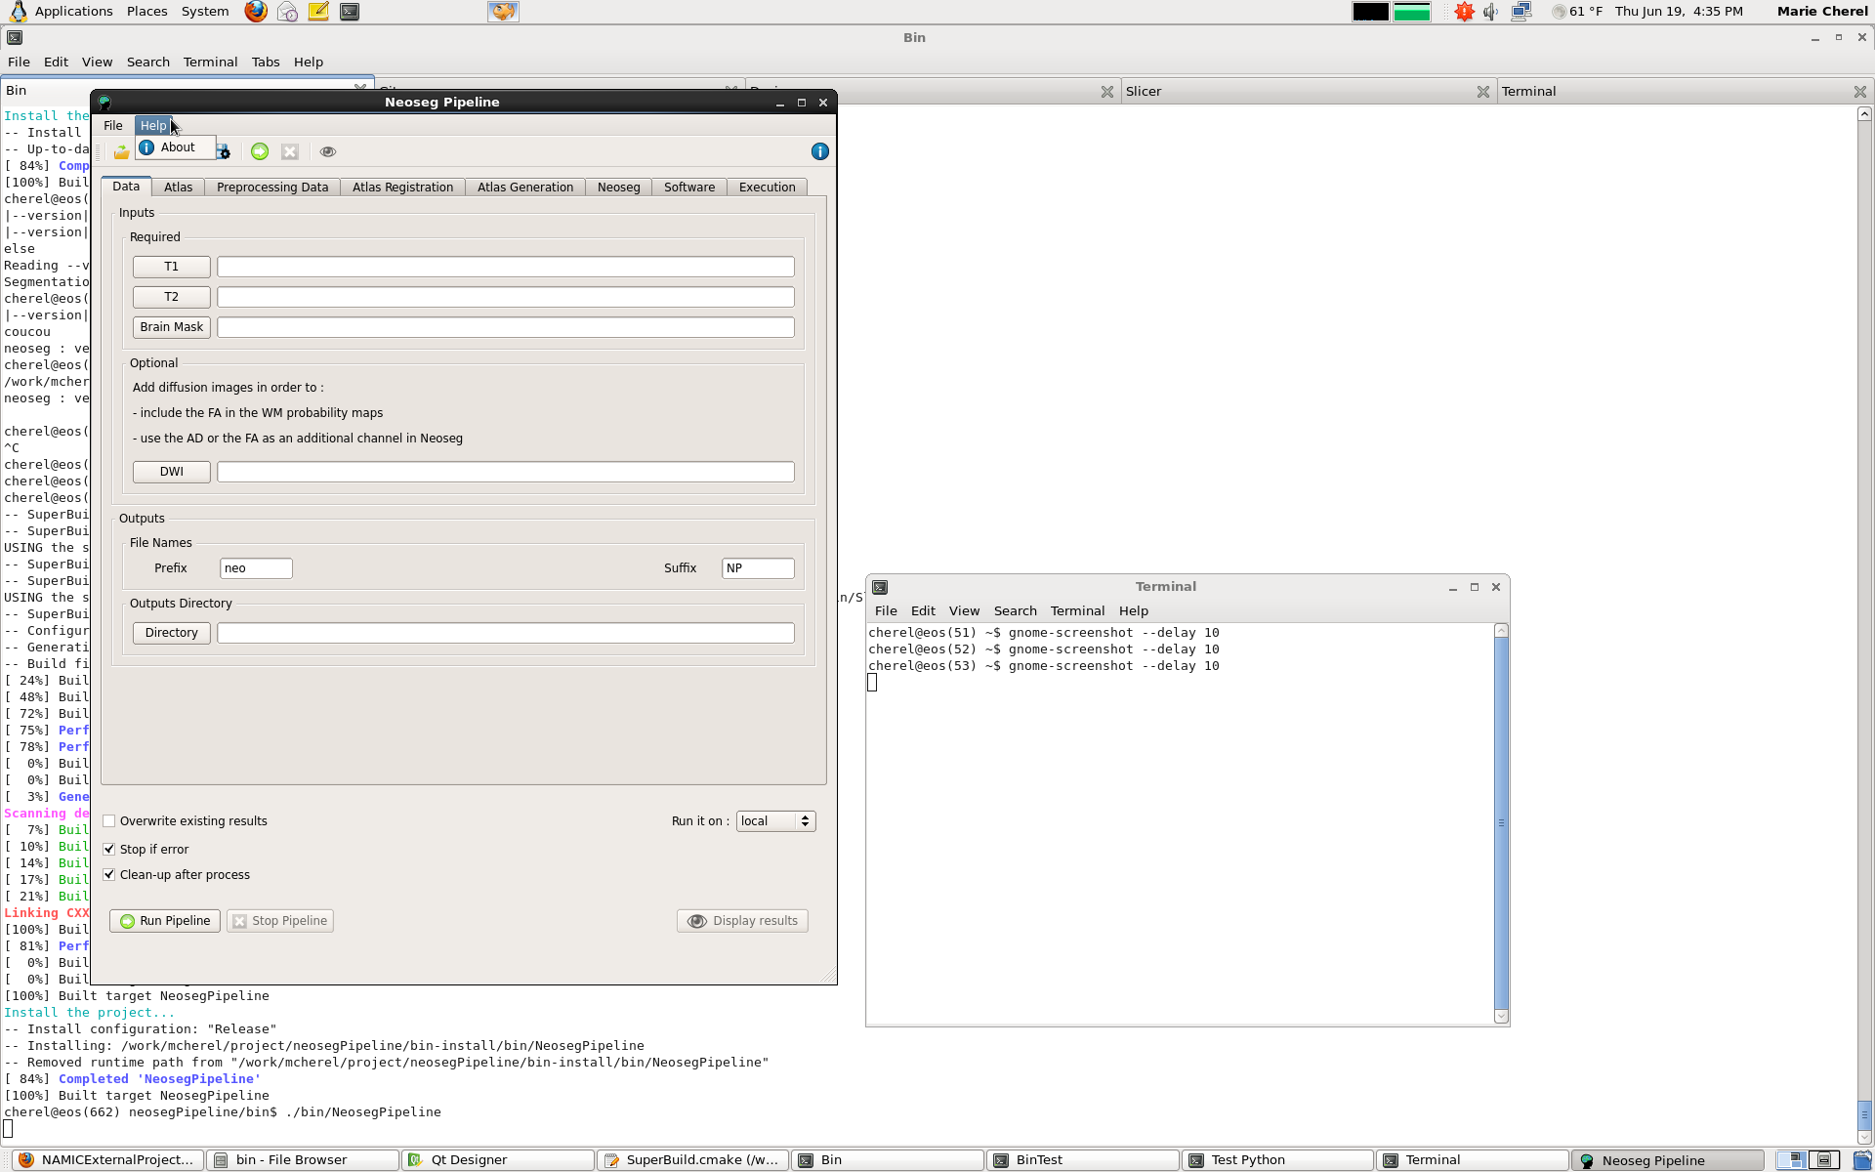
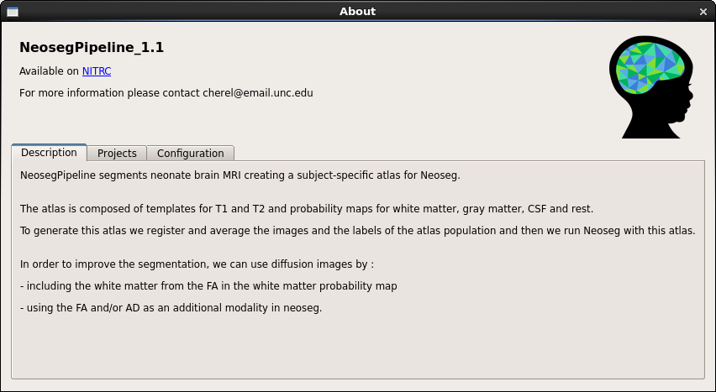
2. Interface
2.2. Menu
The menu contains:
A File section
A Help section
The File section allows to load and save XML files for the configuration of the paramaters and software.
The Help section allows to open an about window with some basic information about the tool.

Slide 7








2. Interface
2.3. Toolbar
The toolbar contains shortcuts to the different actions:
Load an XML file for the parameters configuration
Save an XML file for the parameters configuration
Load an XML file for the software configuration
Save an XML file for the software configuration
Run the pipeline
Stop the pipeline
Display the T1 and T2 images and the final segmentation
Open the about window

Slide 8
2. Interface
2.4. Tabs
1 tab for the data
1 tab for the atlas
1 tab per step
Pre-processing
Atlas Population Registration
Atlas Generation
Neoseg Execution and post-processing
1 tab for the software configuration
1 tab for the execution

Slide 9
2. Interface
2.4. Tabs
2.4.1. Data tab
Required input:
a T1 weighted image
a T2 weighted image
a brain mask
Optional input:
a DWI (Diffusion Weighted Image) (to include the FA in the propability maps and/or add the AD as an additional modality in Neoseg and/or reassign the small islands of WM)
Output
an output directory where all the files generated will be written
a prefix (that can be related to the neonate to segment, eg: « BUSS_1234 » or « 1234 »)
a suffix (that can be related to the tool used, by default « NP » for NeosegPipeline)

Slide 10

2. Interface
2.4. Tabs
2.4.1. Data tab
For each file or directory you can either:
Select it by clicking on the button to open a file browser
Enter the path in the line edit

Slide 11
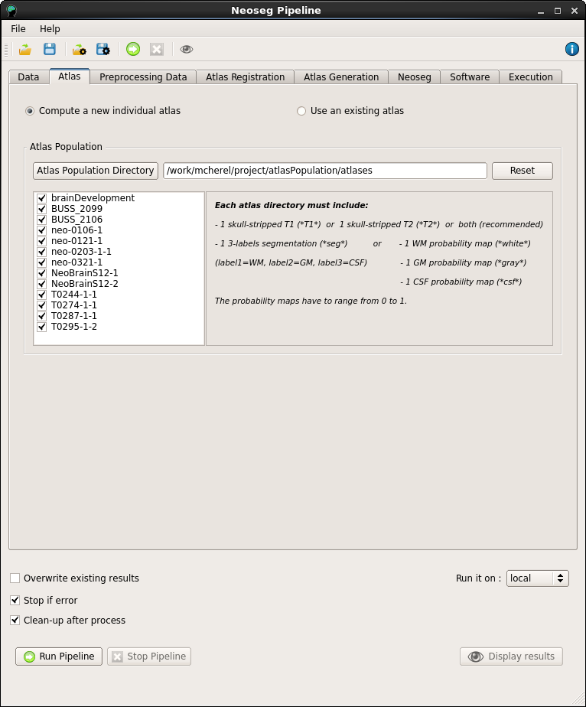
2. Interface
2.4. Tabs
2.4.2. Atlas tab
For the atlas you can either:
Generate a new subject-specific atlas based on an atlas population
Use an existing atlas, subject-specific or not
By default the generation of a new subject-specific atlas is selected

Slide 12
2. Interface
2.4. Tabs
2.4.2. Atlas tab
To generate a new subject-specific atlas, the pipeline requires an atlas population = set of cases called «atlases»
These atlases can either be probabilistic or non-probabilistic:
Non-probabilistic cases must include:
a T1 image
a T2 image
a 3-labels segmentation (label0 = BG, label1 = WM, label2 = GM, label3 = CSF)
Probabilistic cases must include:
a template T1
a template T2
a probability map for WM
a probability map for GM The probability maps have to range from 0 to 1
a probability map for CSF

Slide 13
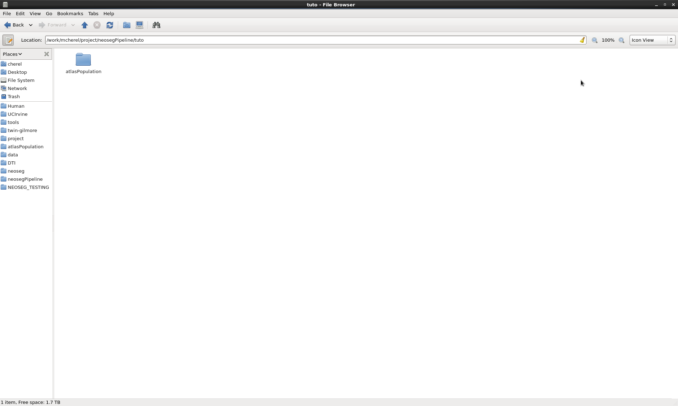
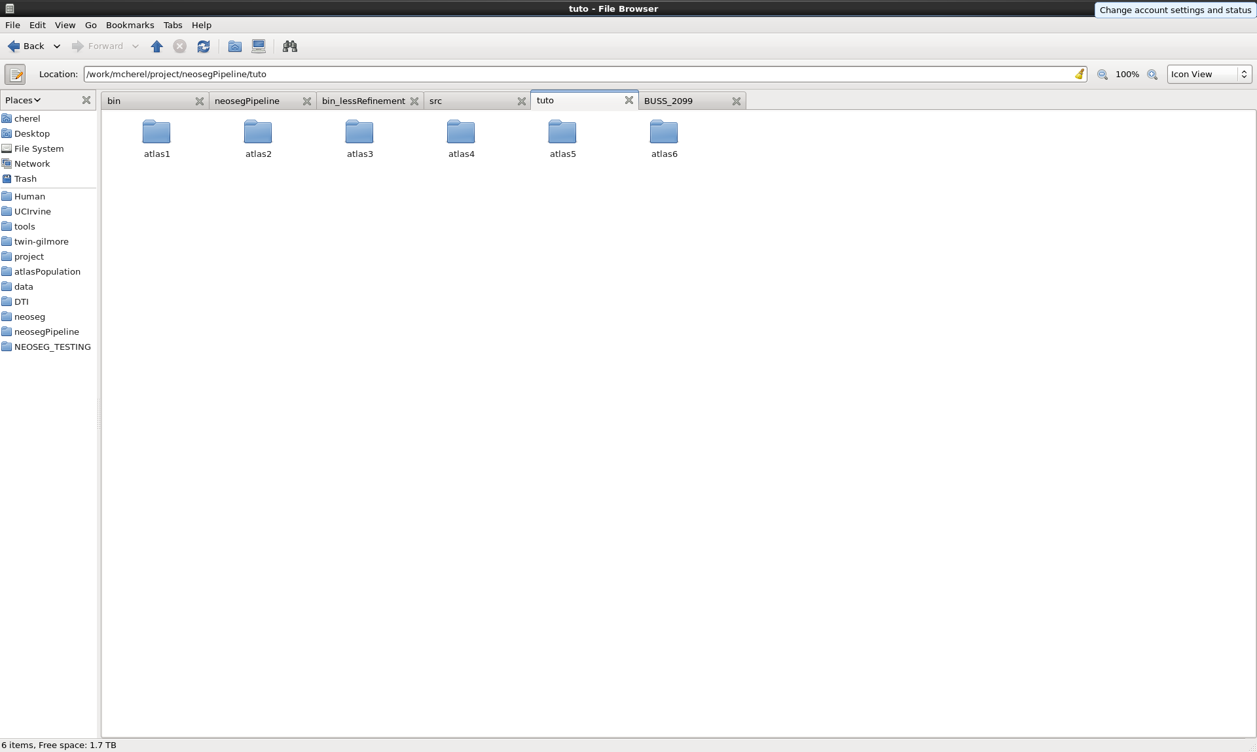
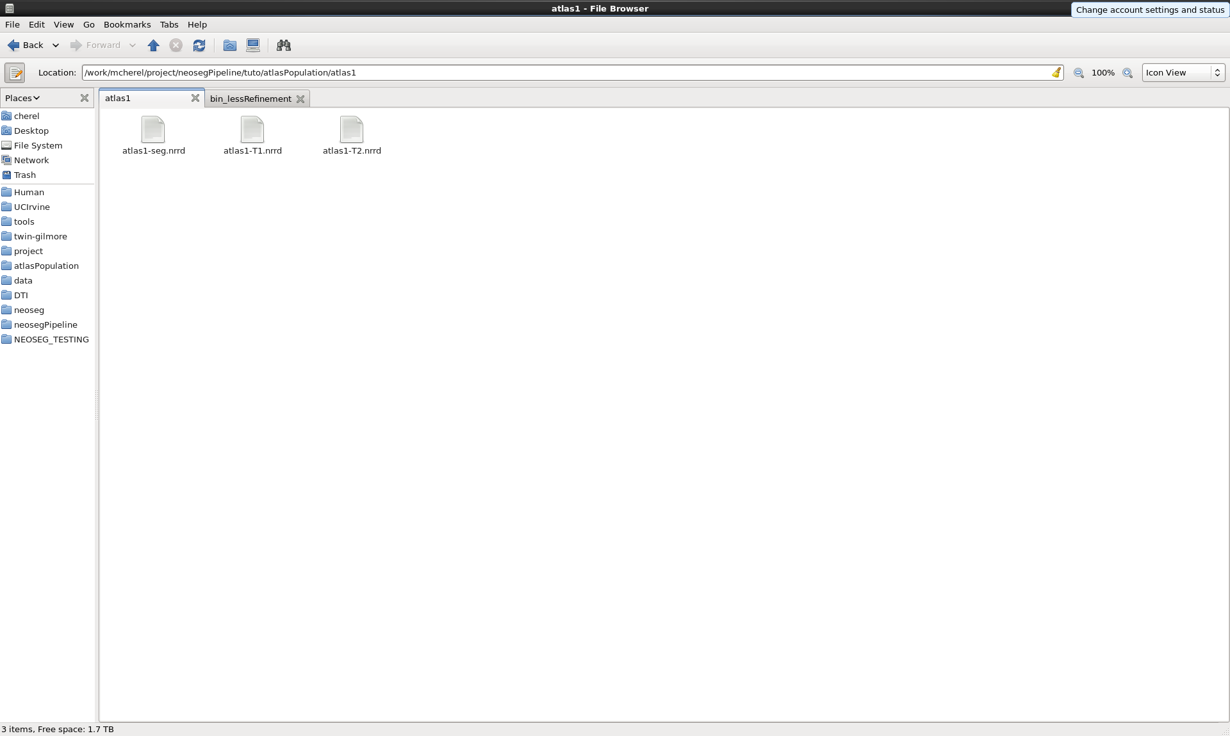
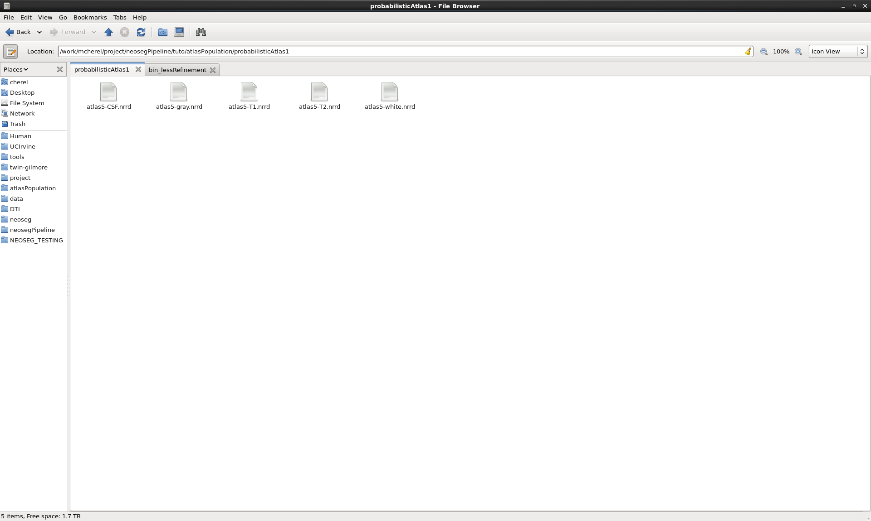
2. Interface
2.4. Tabs
2.4.2. Atlas tab
All the atlases must be gathered in one directory with one directory for each atlas

Slide 14
2. Interface
2.4. Tabs
2.4.2. Atlas tab
To be recognized:
T1 image filenames must contain *T1*
T2 image filenames must contain *T2*
3-labels segmentation filenames must contain *seg*
WM probability map filenames must contain *white*
GM probability map filenames must contain *gray*
CSF probability map filenames must contain *csf*
These keywords are insensitive to the case

Slide 15
2. Interface
2.4. Tabs
2.4.2. Atlas tab [Advanced]
The atlas population directory can be pre-filled by setting the environnement variable : NEOSEG_PIPELINE_ATLAS_POPULATION to the path of the atlas population directory by default.
To set your environnement variable you have to edit your shell configuration file
- In bash you can to edit the .bashrc file located in your home directory Add the line: export NEOSEG_PIPELINE_ATLAS_POPULATION=path
- In tcsh you can to edit the .tcshrc file located in your home directory Add the line: setenv NEOSEG_PIPELINE_ATLAS_POPULATION path
Remark: These configuration files are hidden by default

Slide 16
2. Interface
2.4. Tabs
2.4.2. Atlas tab
Each time the atlas population directory is changed, the list of the atlases available is automatically updated
For each atlas, the presence of the required files is checked
For probabilistic atlases, the range of the probability maps is also checked
If an atlas is not correct, it is disabled and cannot be selected.
By default all the atlases are selected

Slide 17
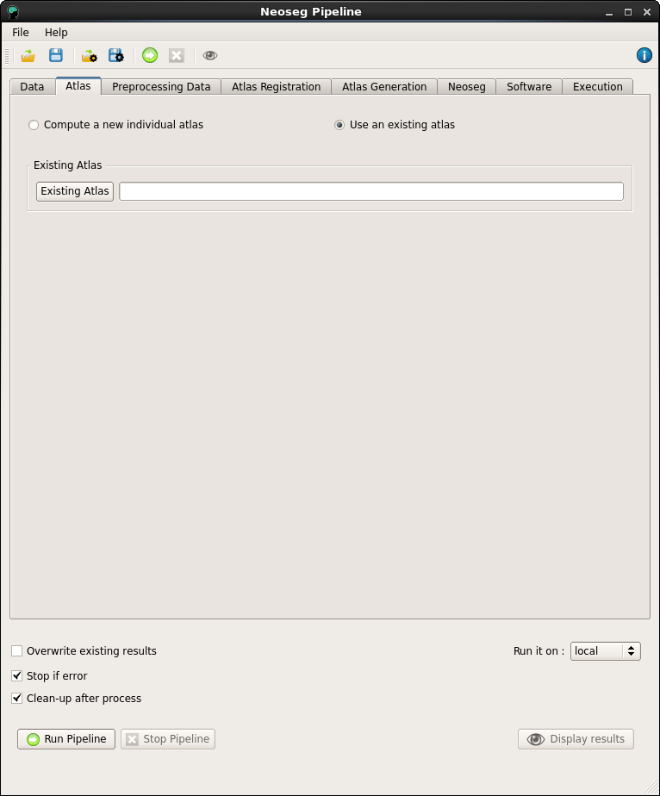
2. Interface
2.4. Tabs
2.4.2. Atlas tab
An existing atlas must include:
a template T1 named « templateT1 »
a template T2 named « templateT2 »
a WM probabilty map named « white »
a GM probability map named « csf »
a rest probability map « rest »

Slide 18
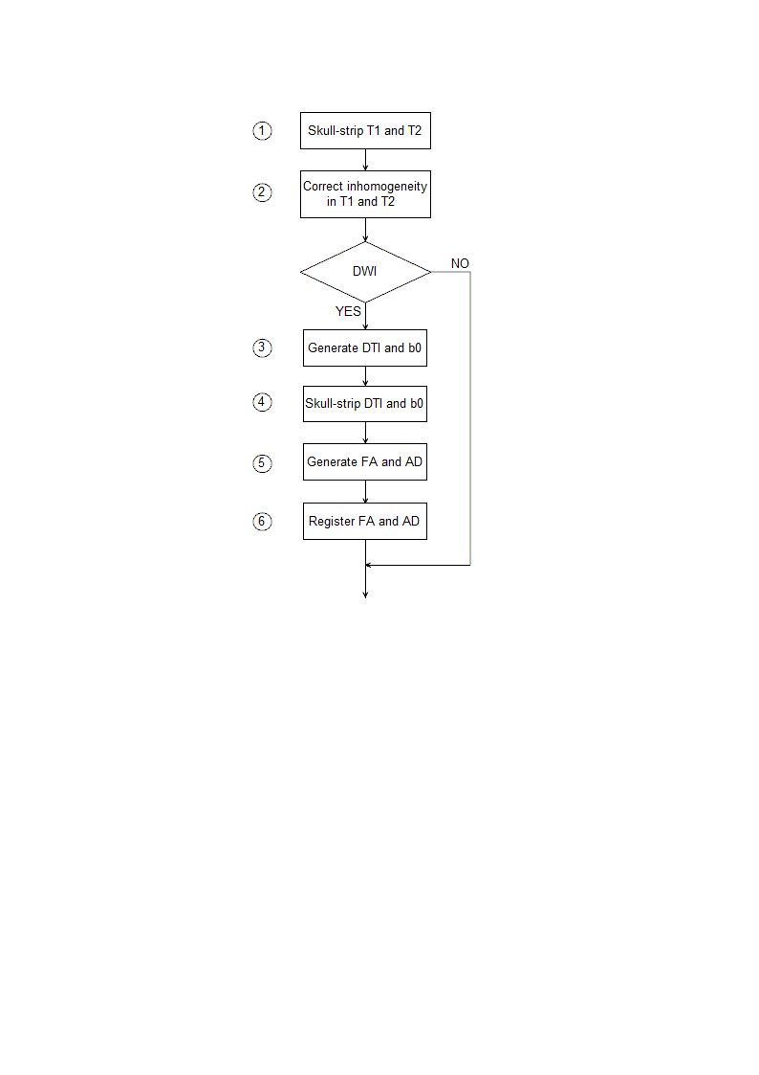
2. Interface
2.4. Tabs
2.4.2. Preprocessing tab
The preprocessing step concerns both:
Structural images
Diffusion images
The different steps of the preprocessing are shown beside:

Slide 19
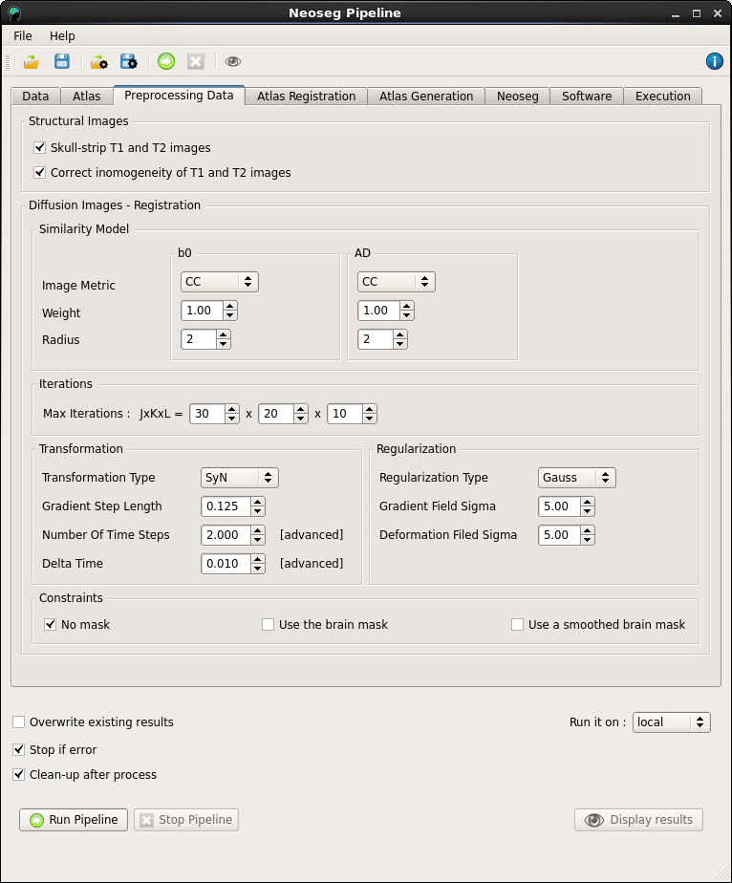
2. Interface
2.4. Tabs
2.4.2. Preprocessing tab
Structural images parameters:
Both the skull-stripping and the inhomogeneity correction can be skipped if already done
Diffusion images parameters :
All the parameters concern the registration part and correspond to the parameters of ANTS. For more informations about the choice of these parameters, refer to the ANTS documentation
(http://sourceforge.net/projects/advants/files/Documentation/)

Slide 20
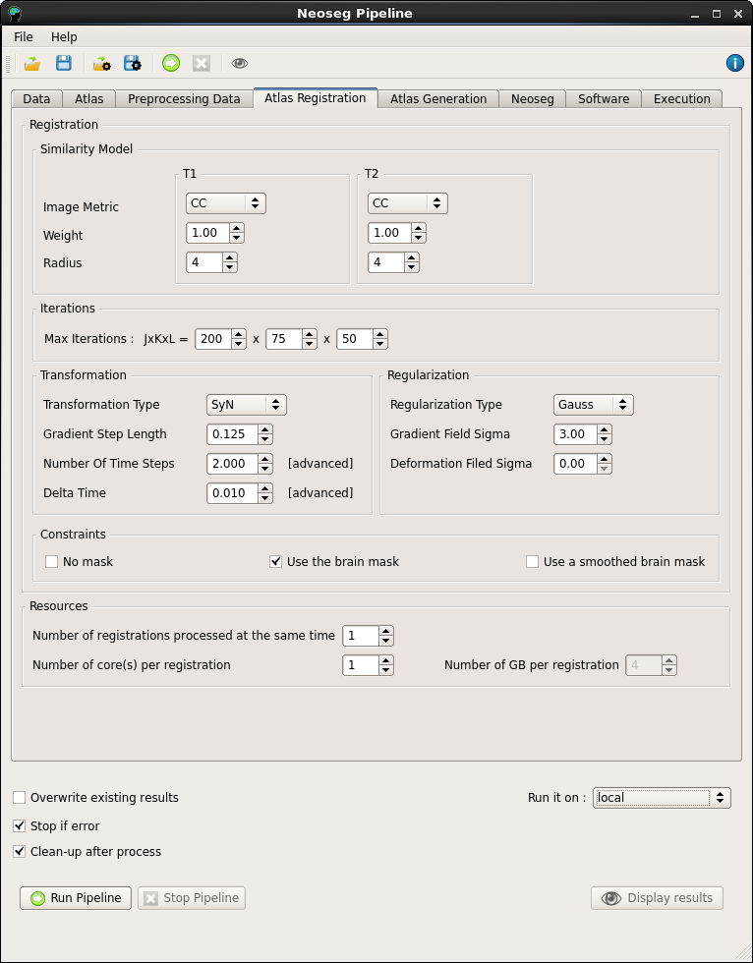
2. Interface
2.4. Tabs
2.4.2. Atlas Registration tab
In this step, all the cases from the atlas population are registered to the case to segment.
The parameters concern both:
The registration
The resources available on the computer

Slide 21
2. Interface
2.4. Tabs
2.4.2. Atlas Registration tab
Registration Parameters:
All the parameters correspond to the parameters of ANTS. For more informations about the choice of these parameters, refer to the ANTS documentation (http://sourceforge.net/projects/advants/files/Documentation/)

Slide 22
2. Interface
2.4. Tabs
2.4.2. Atlas Registration tab
The pipeline can be run
On the current computer (Locally)
On KillDevil (UNC super-computing system)
If the pipeline is run locally, you can choose:
How many registrations are run in parallel (1 by default)
How many cores one registration uses (1 by default)
If the pipeline is run on KillDevil, all the registrations are run in parallel. For each registration you can choose the ressources requested:
How many cores one registration uses (1 by default)
How many GB uses one registration (4GB by default, but it may need to be adjusted depending on the size of the images)

Slide 23
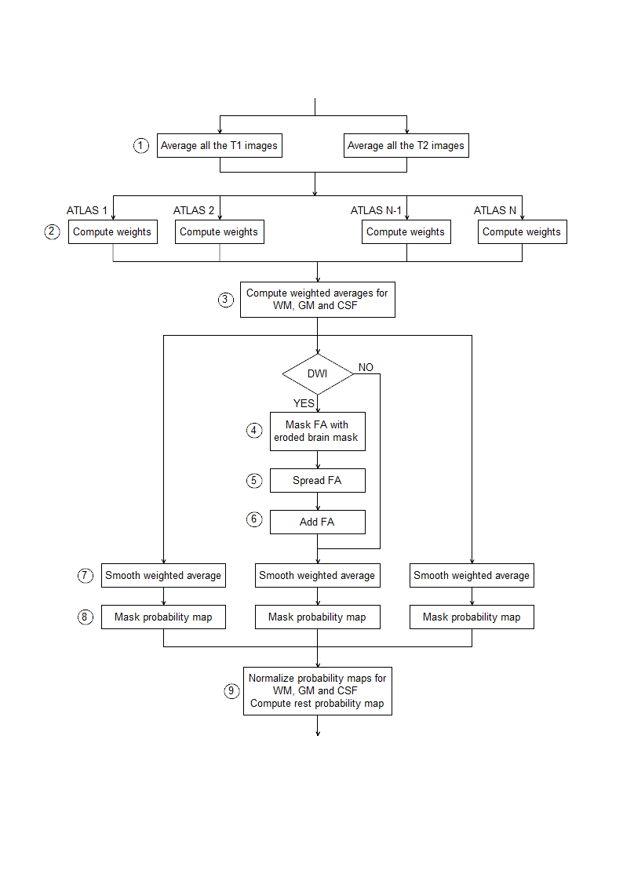
2. Interface
2.4. Tabs
2.4.2. Atlas Generation tab
In this step we generate the subject-specific probabilistic atlas
The different operations are shown beside:

Slide 24
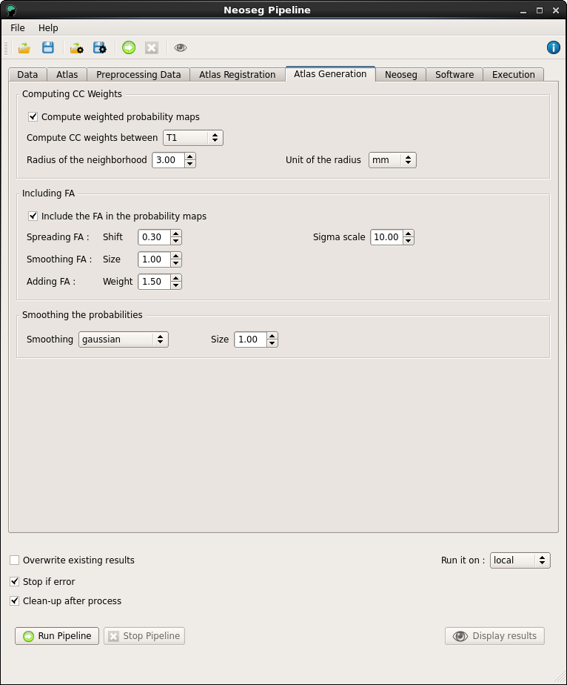
2. Interface
2.4. Tabs
2.4.2. Atlas Generation tab
The parameters concern:
The computation of the weights
The inclusion of the FA in the probability maps
The smoothing of the probability maps

Slide 25
2. Interface
2.4. Tabs
2.4.2. Atlas Generation tab
The computation of the weights allows the atlas to be more adapted to the subject to segment, and thus to give better results
The weights are computed locally, based on the similarity with the subject to segment. The similarity is evaluated with the normalized cross-correlation metric.
Weights parameters:
The computation of the weights is optional (activated by defaut)
The modality (T1 or T2) on which the weights are computed
The radius of the neighborhood and its unit (3mm by default)

Slide 26
2. Interface
2.4. Tabs
2.4.2. Atlas Generation tab
Including the FA in the probability maps can help segmenting the corpus callosum and the internal capsules.
First the FA is masked to keep only the center of the brain, and spread with an error function to keep only the regions where the FA is very high. Then the FA is smoothed and added to the WM average.
Parameters:
The inclusion of the FA in the probability maps is optional (activated by defaut)
The error function used to spread the FA is defined by the shift and the sigma scale
The kernel size of the gaussian smoothing
The weight of the FA when it is added to the WM average

Slide 27
2. Interface
2.4. Tabs
2.4.2. Atlas Generation tab
The probability maps are smoothed to convert discrete values to continuous values
The more atlases are in the atlas population, the smaller the smoothing kernel size has to be
Parameters:
Type of smoothing (Gaussian or Curve Evolution, Gaussian by default)
Size of the kernel (1mm by default)

Slide 28
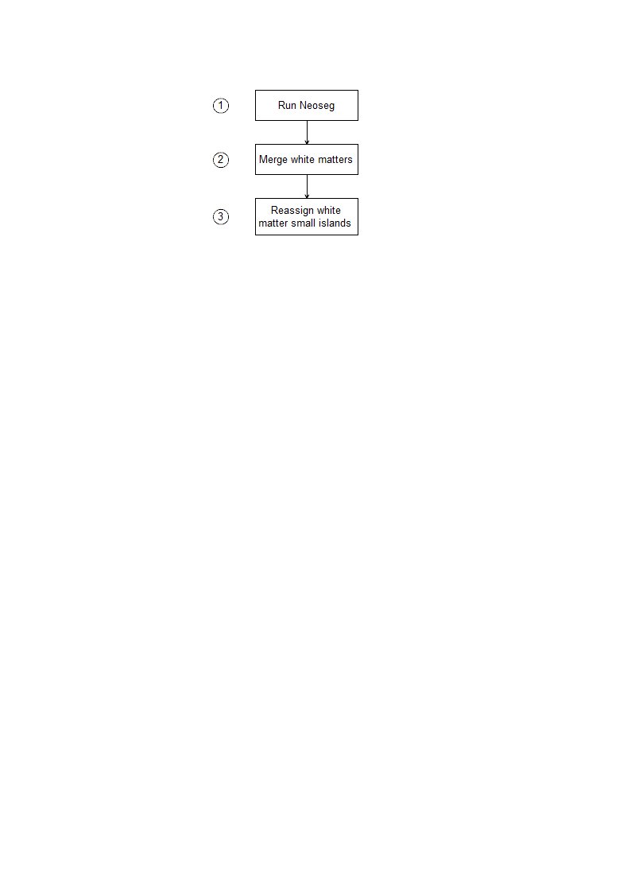
2. Interface
2.4. Tabs
2.4.2. Neoseg tab
In the Neoseg step, we compute the segmentation.
The different steps are shown below:

Slide 29
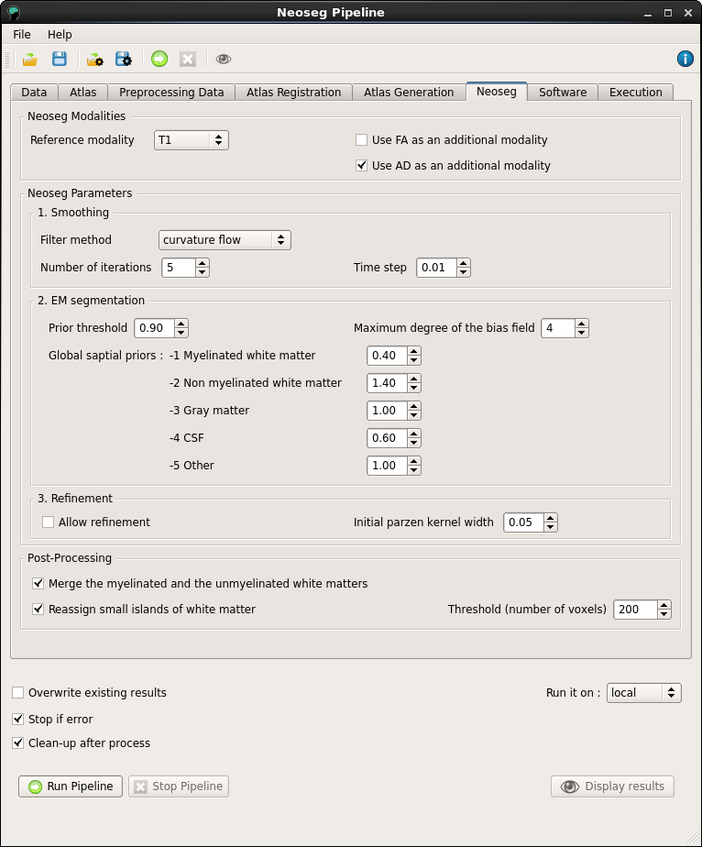
2. Interface
2.4. Tabs
2.4.2. Neoseg tab
Neoseg is a single atlas segmentation method based on an Expectation Maximisation (EM) algorithm
All the parameters correspond to the parameters of Neoseg. For more information about the choice of these parameters, refer to the Neoseg documentation (???)

Slide 30
2. Interface
2.4. Tabs
2.4.2. Neoseg tab
In the post processing steps, we merge the myelinated and unmyelinated WM and remove the small islands of WM by reassigning them.
Parameters
- The merging of the unmyelinated and myelinated WM is optional (activated by default)
- The reassigning of WM small islands is optional (activated by default)
- The threshold for the WM small islands (200 pixels by default)

Slide 31
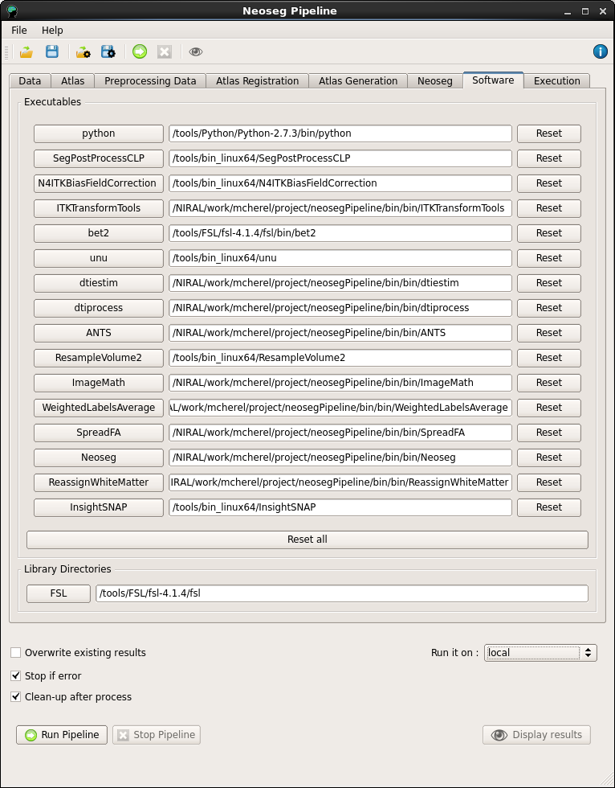
2. Interface
2.4. Tabs
2.4.2. Software tab
The pipeline requires several external executables and libraries.

Slide 32
2. Interface
2.4. Tabs
2.4.2. Software tab
The pipeline requires several extarnal executables. Only InsightSNAP is optional because it is used only for the display of the results.
NeosegPipeline automatically searches the executables in the current directory and in the PATH.
NeosegPipeline checks if the file is executable and if the output of the command «--version» or «--help» is consistent.
Each executable can be changed directly in the GUI by opening a browser window or entering the path of the executable

Slide 33
2. Interface
2.4. Tabs
2.4.2. Software tab
Some executables also require libraries whose directory paths are defined in environnement variables
NeosegPipeline automatically searches for the environnement variables corresponding to the libraries needed
The library directory can be selected by opening a browser window or by entering the path.

Slide 34
2. Interface
2.4. Tabs
2.4.2. Software tab
To use a specific set of software you can load a XML files with all the paths of the executables and library directories
A XML file for the software configuration can be automatically loaded by setting the environnement variable: NEOSEG_PIPELINE_EXECUTABLES to the path of the XML file by default.
To set your environnement variable you have to edit your shell configuration file
- In bash you can to edit the .bashrc file located in your home directory Add the line: export NEOSEG_PIPELINE_EXECUTABLES =path
- In tcsh you can to edit the .tcshrc file located in your home directory Add the line: setenv NEOSEG_PIPELINE_EXECUTABLES path
Remark: These configuration files are hidden by default

Slide 35
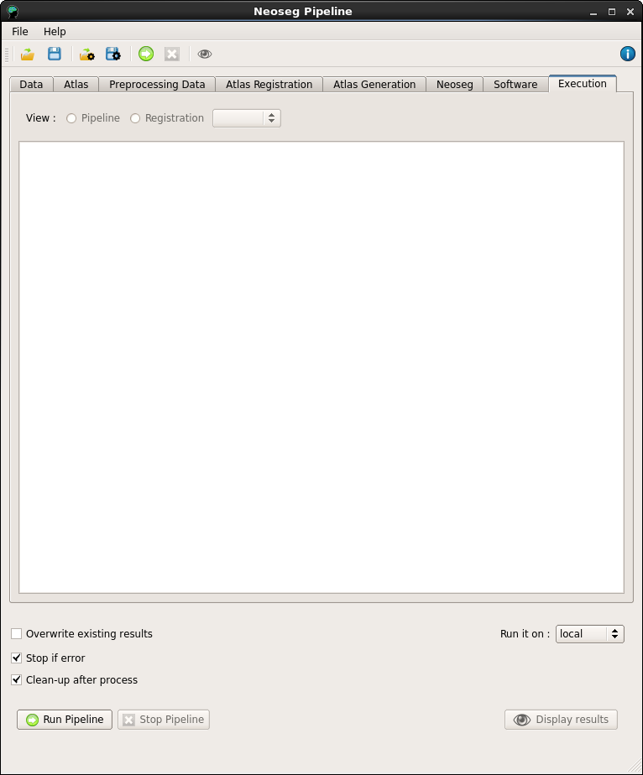
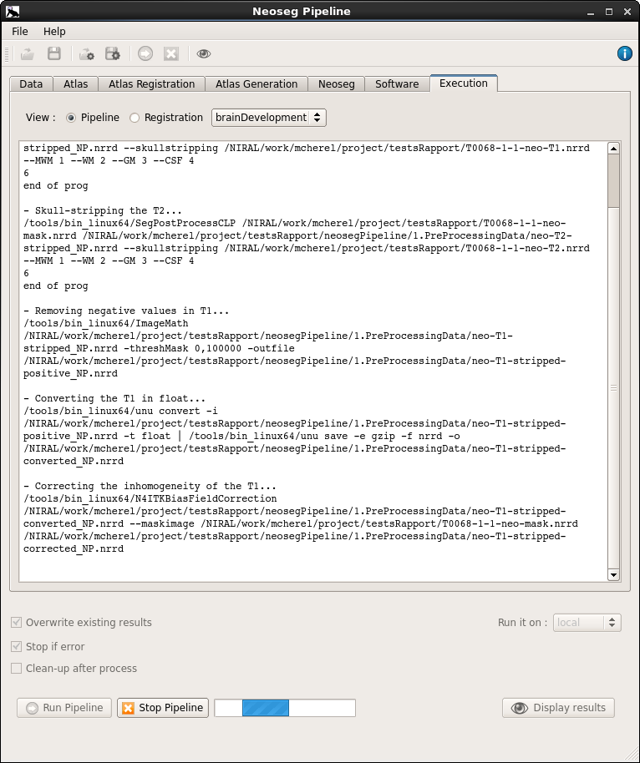
2. Interface
2.4. Tabs
2.4.2. Execution tab
This tab allows to follow the progress of the pipeline.
All the command lines and their outputs are displayed in the text area.
It is also possible to display the log of the registrations by checking the registrations radio button and selecting the atlas you want to see the execution of the registration.

Slide 36
2. Interface
2.5. Computation area
The computation area gathers some general options about the execution and computation of the pipeline.
The «overwritting existing results» option allows using the existing results or restarting the pipeline from scratch (desactivated by default)
The «stopping if error» option allows to stop if a error occured (activated by default)
The «cleaning-up» option allows to remone the transitional files. If the pipeline failed, the output directory is not cleaned to make the debugging easier (activated by default)

Slide 37
2. Interface
2.5. Computation area
The pipeline can be run:
On the current computer (Locally)
On KillDevil (UNC super-computing system)
Given these two computing systems, the pipeline can be run in three ways:
Locally
On KillDevil
On KillDevil «interactive»
When running the pipeline on killdevil, the submission of an independant job prevents the printing of the log. Only the busy indicator shows if the pipeline is still running or not. Nevertheless the pipeline is still writing a log file that can be displayed at anytime.
With the KillDevil interactive option, the pipeline is run in a interactive job. This way the main script is running in the same job as the interface and the log can be printed. However NeosegPipeline is still submitting a new job for each registration, thus the execution of the registrations is still unaivalable for printing

Slide 38
2. Interface
2.5. Computation area
To run the pipeline in KillDevil (option « KillDevil » or « KillDevil interactive ») you first need to connect to KillDevil with the command line: « ssh killdevil.unc.edu »
To run the pipeline with the « KillDevil » option, you just have to launch NeosegPipeline with the command line: « NeosegPipeline + arguments »
To run the pipeline with the « KillDevil interactive » option , you have to launch NeosegPipeline in an interactive job with the following command: « bsub -q day -n 1 –M 4 –R «span[hosts=1]» NeosegPipeline + arguments »

Slide 39
2. Interface
2.5. Computation area
When pressing the « Run pipeline » button, NeosegPipeline
Check the data, parameters and software
Write the Python scripts
Run the Python scripts
When the pipeline is running, the busy indicator is shown and the modification of options or parameters is disabled.
When pressing the « Stop pipeline » button, Neoseg Pipeline terminate the execution of all the Python scripts.
Then the parameters can be changed and the pipeline restarted as many times as necessary

Slide 40
3. Command line interface (CLI)
NeosegPipeline also has a command line interface (CLI) that allows passing arguments for the data, parameters and software.
The execution of the command « NeosegPipeline --help » will give you more information about the syntax of the command line.
Here is an example of a command line: « NeosegPipeline – output output_directory --T1 T1.nrrd --T2 T2.nrrd --mask mask.nrrd --DWI DWI.nrrd --parameters parameters.xml --executables executable.xml »
If opening the GUI, the fields are pre-filled with the values passed through the command line but they can still be modified.
It is also possible not opening the GUI and launching directly the pipeline by adding the flag « --noGui ». (If you do not want to open the GUI, be sure to pass all the data required)

