Slide 1
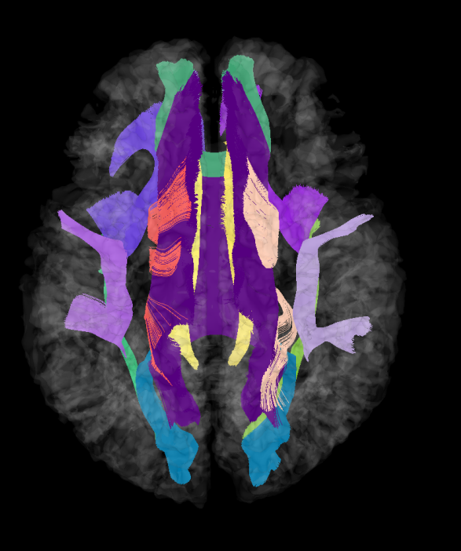
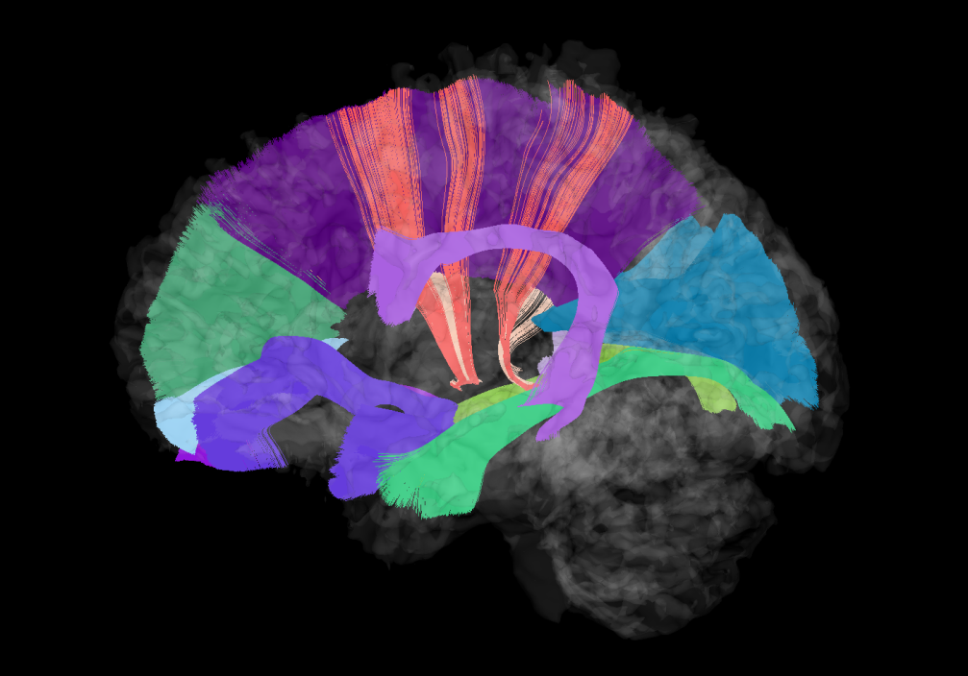
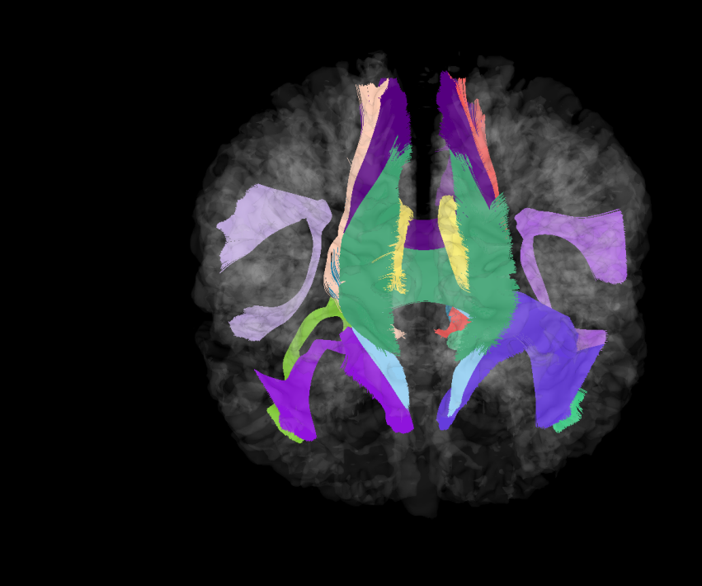
Tutorial: AutoTract

Slide 2
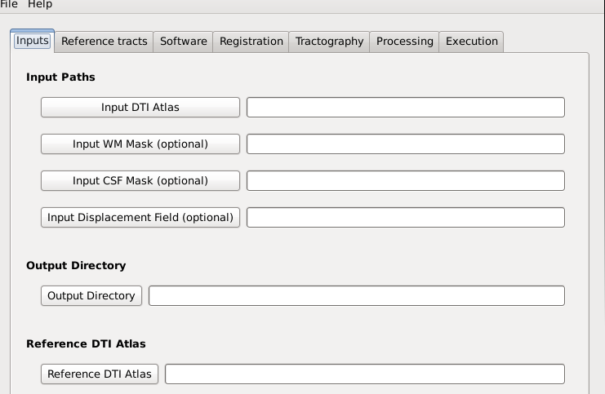
Input tab
Insert the path to the DTI Image that you want to tract.

Slide 3
Input tab
(optional)If you already have a WM/CSF mask you want to use to process the tracts, insert the path here.
Otherwise the masks are computed automatically.

Slide 4
Input tab
(optional)If you already did the registration and have the displacement field, insert the path to the displacement field here to skip the registration process.

Slide 5
Input tab
Insert the path to the repository where the output files should be written.

Slide 6
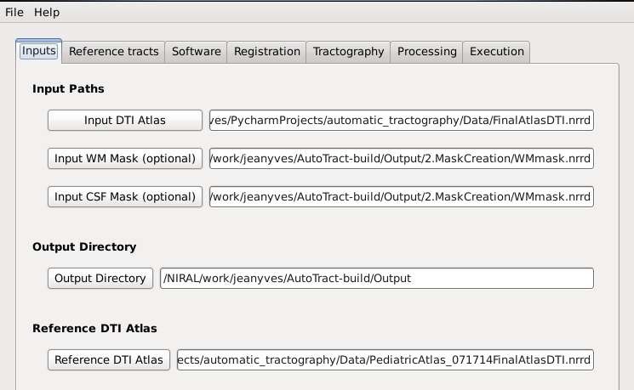
Input tab
Insert the path to the reference DTI atlas pre-tracted.

Slide 7
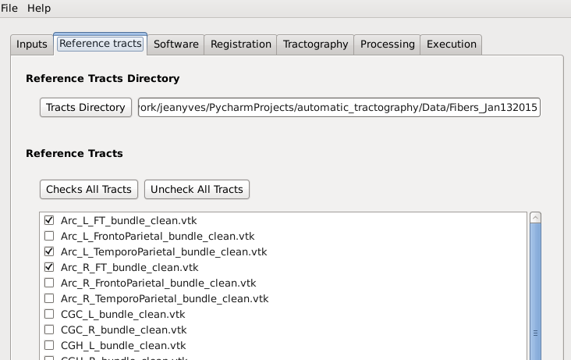
Reference tracts tab
Insert the path to the repository that contains the tracts from the reference DTI image given in the input tab.
Check the names of the tracts that you want to tract and process.

Slide 8
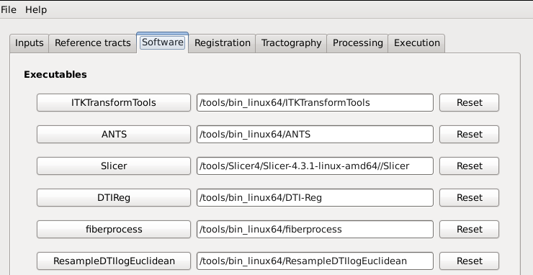
Software tab
Insert the path to the executables of each software if missing.

Slide 9
Registration tab
Registration type: (default: Greedy Diffeo)
Transformation step: (default: 0.25)
Iterations: (default: 00x50x25)
Similarity Metric: (default: CC)
Similarity Parameter: (default: 4)
Gaussian Sigma: (default: 3)

Slide 10
Tractography tab
Dilation radius: (default: 2.00) increasing it means the label maps will be dilated, so the output tracts after the tractography will contain more fibers (less strict, but potentially more unwanted fibers).
Seed Spacing: (default: 0.50mm) a high value will be faster to compute but less accurate (less seeds).
Linear Measure Threshold: (default: 0.15mm)
Min/Max path length: (default: 10 – 800 mm) min/max length of the fibers.

Slide 11
Tractography tab
Stopping value: (default: 0.12)
Integration Step Length: (default: 0.40°/mm)
Stopping Curvature: (default: 0.30mm) if the tracts have a high curvature, you may need to lower this parameter. Otherwise it can be set higher (the tractography will take less time), eg. 0.50 mm.

Slide 12
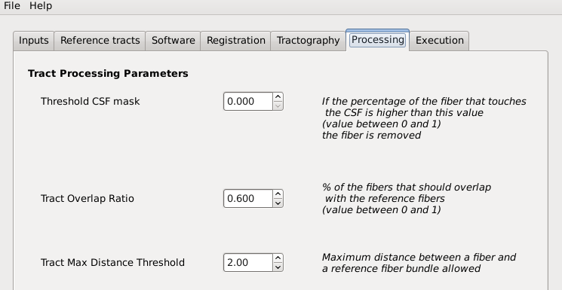
Processing tab
(default: 0.001): 0 means that all tracts in the grey matter (determined by the WM mask given or computed) will be excluded.

Slide 13
Processing tab
(default: 0.6): 1 means that the tracts obtained after the tractography should be identical to the reference tracts, 0 means the tracts should not have a point in common with the reference tracts.

Slide 14
Processing tab
(default: 0.001): 0 means that all tracts in the grey matter (determined by the WM mask given or computed) will be excluded.

Slide 15
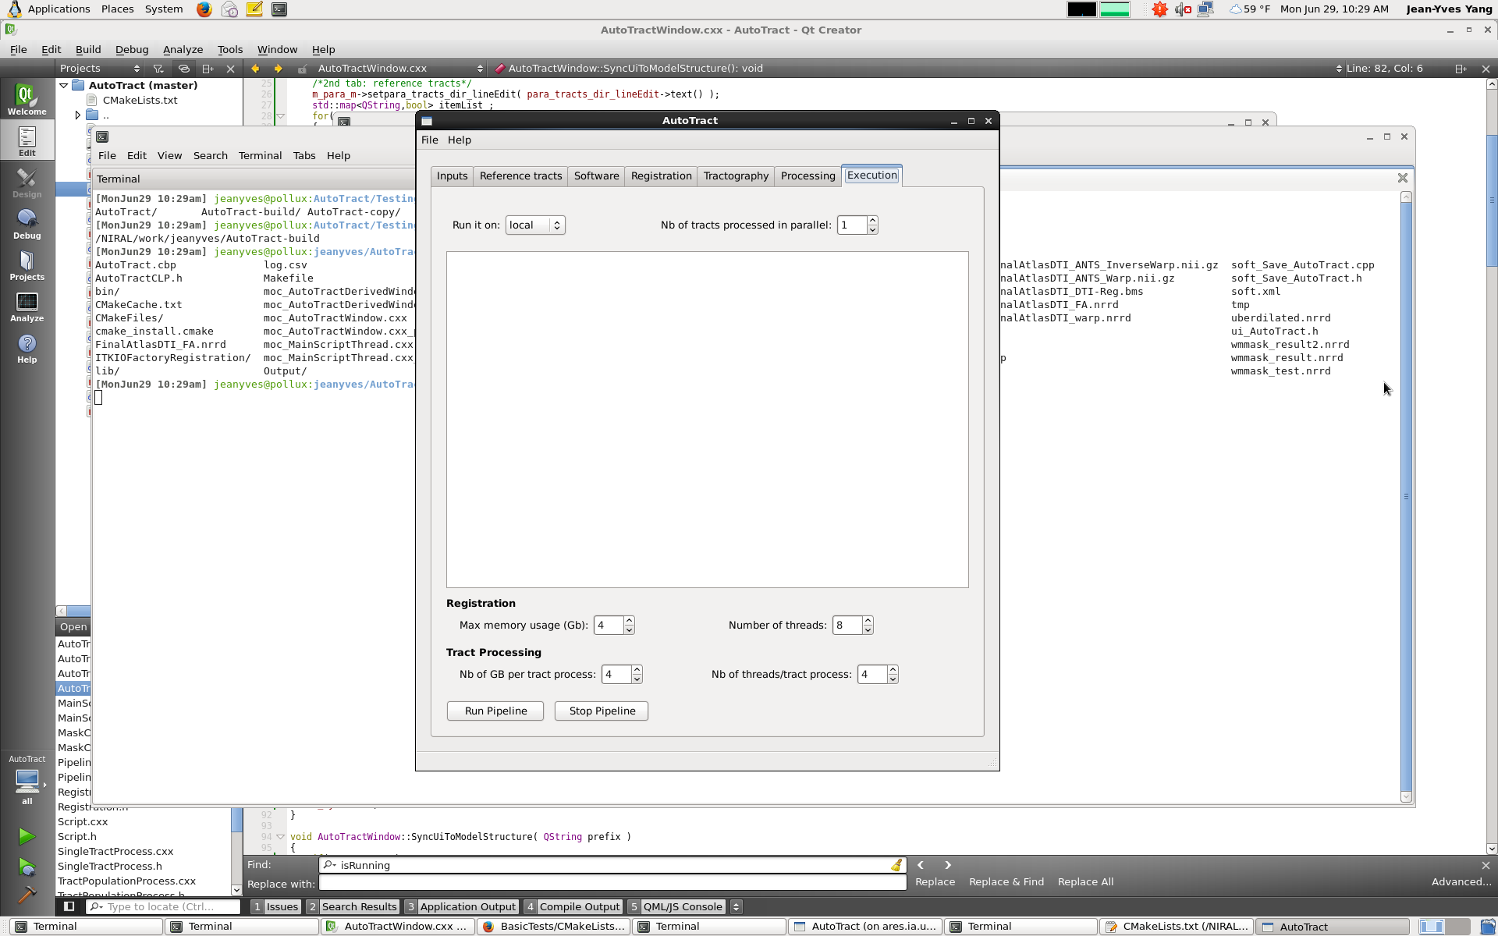
Execution tab
Local: run on your own machine.
Killdevil: run on the killdevil cluster.

Slide 16
Execution tab
(only on local, on killdevil it’s set by default to the maximum value).
Careful not to set it too high to avoid freezing the system.

Slide 17
Execution tab
Log window: It will display information concerning the process when it is running.
(Notably, it will display which step is being processed: registration, mask creation, tractography label map seeding, post process)

Slide 18
Execution tab
Max memory usage (registration): max amount of memory in Gb that the registration process (ANTS, launched by DTI-Reg) can use. (default: 4Gb)

Slide 19
Execution tab
Number of threads (registration): A high number of threads will make the registration process faster.

Slide 20
Execution tab
Nb of GB per tract process: Max amount of memory allocated for each tract process.
Careful not to allocate it too high when running on killdevil.

Slide 21
Execution tab
Nb of threads/tract process: A high number of threads will make the tract process faster.
Careful not to allocate it too high when running on killdevil.

Slide 22
Execution tab
Once all the parameters are set, click on run pipeline to start the process. It will take some time, you can close the window and let the process run (click no when asked if you want to kill all the processes).

Slide 23
Output
4 folders will be created in the output directory that you specified in the input tab:
1. Registration
2. MaskCreation
3.PostProcess
Script
A file called Output.log will contain what was written in the log window.

Slide 24
Output
1.Registration
It will contain the displacement field under the name displacementField.nrrd
2.MaskCreation
FAimage.nrrd and MDimage.nrrd are the FA/MD of the input DTI Image (obtained using dtiprocess)
brainskull.nrrd is a temporary file generated when computing the CSF mask.
The masks generated and used for computation are called: WMmask.nrrd and MDmask.nrrd.
upsampledImage is generated at the same time and is also necessary for the post processing of the tracts.

Slide 25
Output
3.PostProcess
1 subfolder will be created for each tract. In this subfolder named [name_of_tract], there will be:
  [name_of_tract]_processed.vtp, the actual output.
  [name_of_tract].log, the log file containing additional details about the process of the tract.

Slide 26
Intermediate Outputs
3.PostProcess
The other (temporary) files are created during the intermediate steps of the process in this order:
  [name_of_tract]_t.vtk: mapped reference tract(using the displacement field computed/given as an input).
  [name_of_tract].nrrd and [name_of_tract]_dil.nrrd: voxelization followed by a dilation of the mapped reference tract.
  [name_of_tract].vtp: output of the tractography label map seeding (before any additional post processing).

Slide 27
Intermediate Outputs
3.PostProcess
  [name_of_tract]_ref_cleanEnds.vtp: mapped, voxelized and dilated reference tract processed by cutting the ends of each fiber outside of the WM mask.
  [name_of_tract]_cleanEnds.vtp: same process than [name_of_tract]_ref_cleanEnds.vtp on the tract obtained via TractographyLabelMapSeeding instead of the reference tract.
  [name_of_tract]_maskCSF.vtp: all the fibers that touched the CSF gets removed.

Slide 28
Intermediate Outputs
3.PostProcess
  [name_of_tract]_maskTract.vtp: masked with [name_of_tract]_ref_cleanEnds.vtp to ensure that the output tract has a similar « shape ».
  [name_of_tract]_lengthMatch.vtp: compare length of the output tract with the reference tract, remove any fibers that are too small or too tall.
  [name_of_tract]_processed.vtp: final output (not a temporary file), obtained by masking with a distance map generated using the reference tract (to ensure that the output tract is close to the reference tract).

