Slide 1

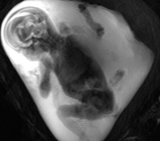
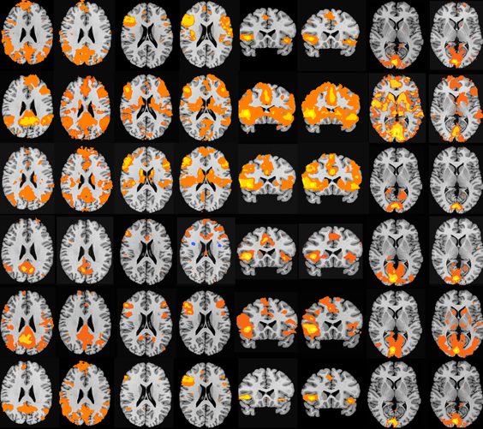
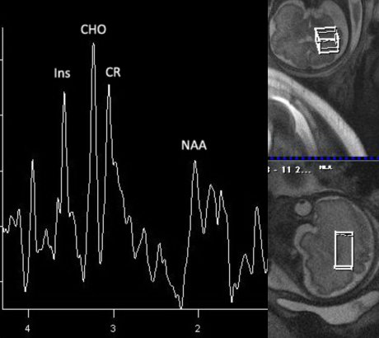
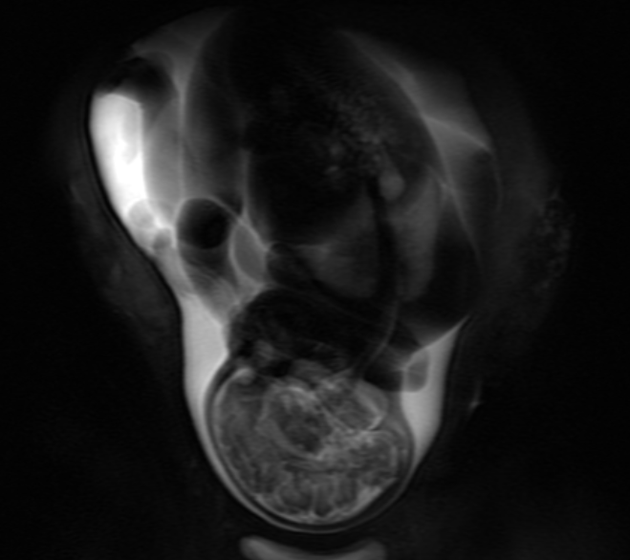

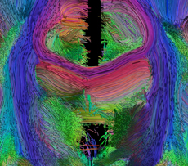
Fetal Magnetic Resonance Imaging Research
Postdoctoral Training in Multi-Modal MR Imaging
Wayne State University, Detroit, MI
Principal Investigator:
Moriah E. Thomason, PhD
Postdoctoral position available in the Thomason SCAN laboratory (www.brainnexus.com) at Wayne State University. Our research examines different aspects of cognition and emotion as a function of psychiatric health, risk for psychological disorder, developmental stage, and genetic polymorphisms. Research focuses on brain development in the human fetal period, childhood and adolescence and utilizes fMRI, functional connectivity (FC), DTI, MRS and perfusion approaches. The position includes ample RA support and collaborations with graduate students and faculty. The ideal candidate will have several of the following qualifications: (1) background in developmental neuroscience research; (2) experience in fMRI (e.g., SPM, FSL), FC or DTI; (3) programming skills (e.g., Matlab, x11); (4) expertise in statistics; and (5) a promising publication record. Send a statement of research interests and a CV.
Application Deadline:
May 7, 2012
For a start date in September 2012
Applications must have a PhD or MD and must be US citizens or permanent residents.
Inquires to Andrea Bedway
(313)664-2521; abedway@med.wayne.edu

