Slide 1
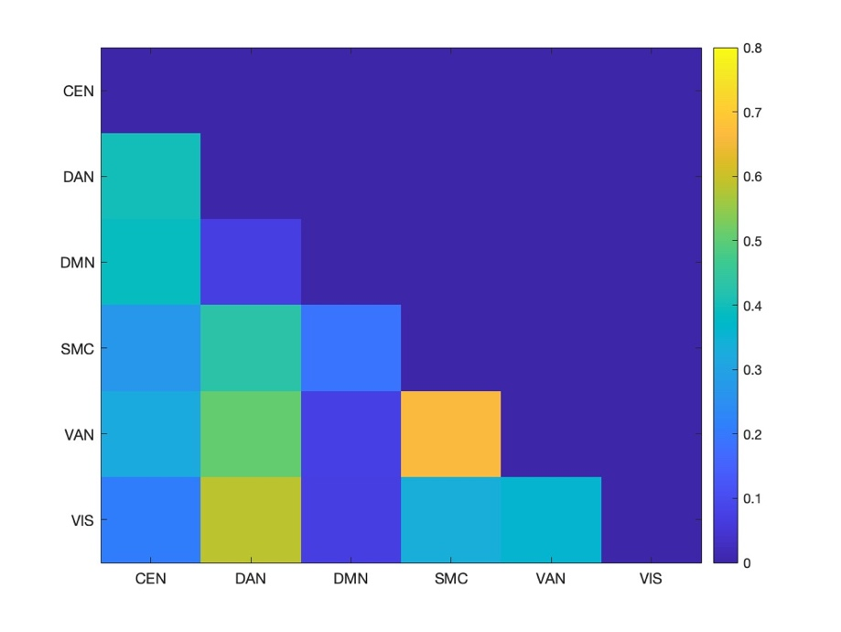
Previous project (resting-state in adolescents)

Slide 2
Current project (task-based in adolescents)

Slide 3
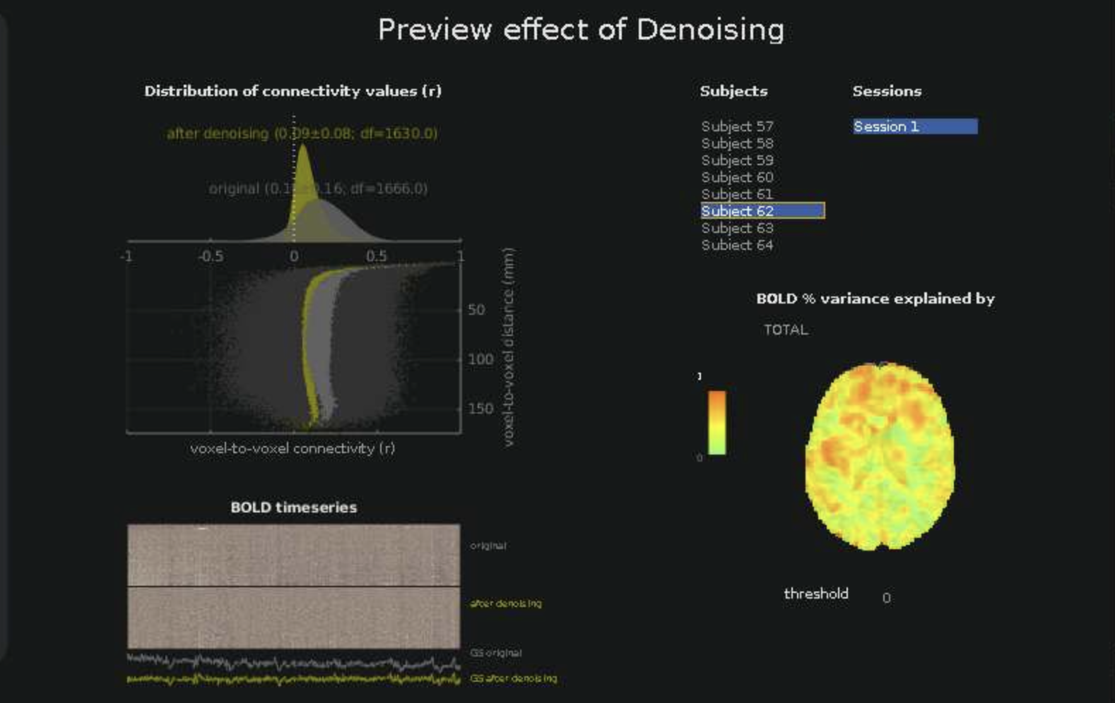
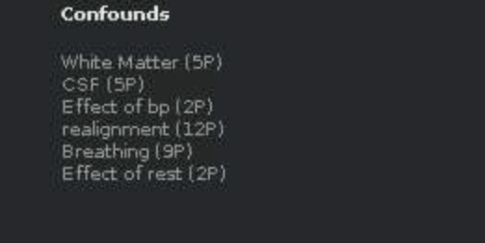

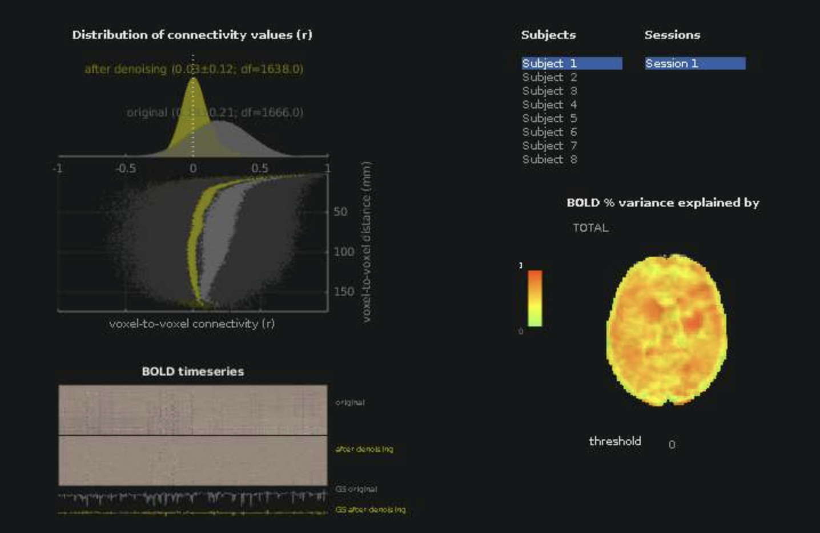
RETROICOR- breath belt AND
BUTTON PRESSES REGRESSED OUT

Slide 4
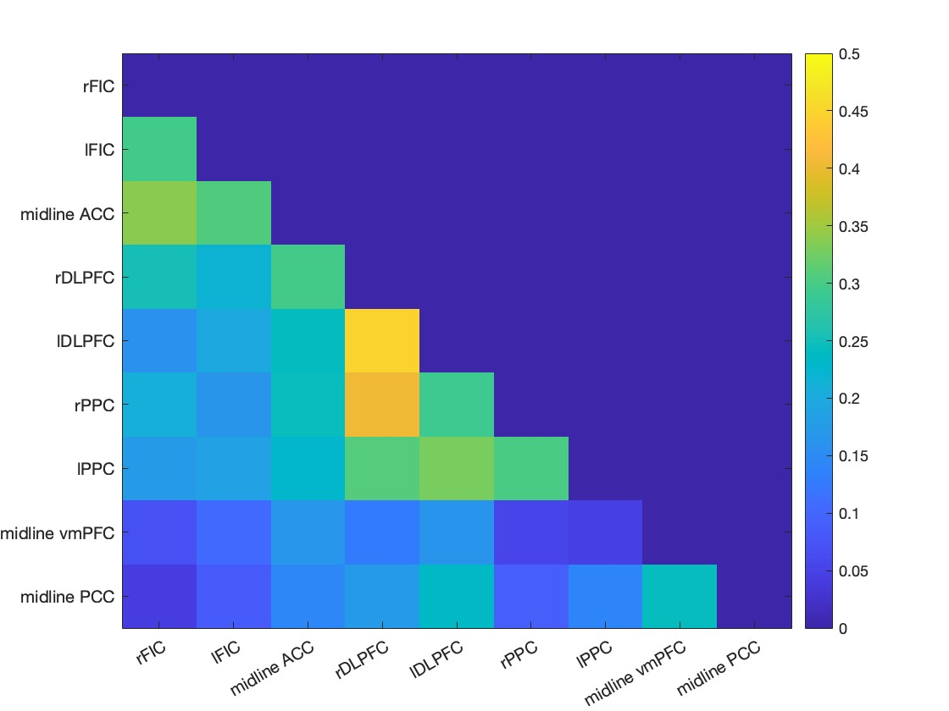
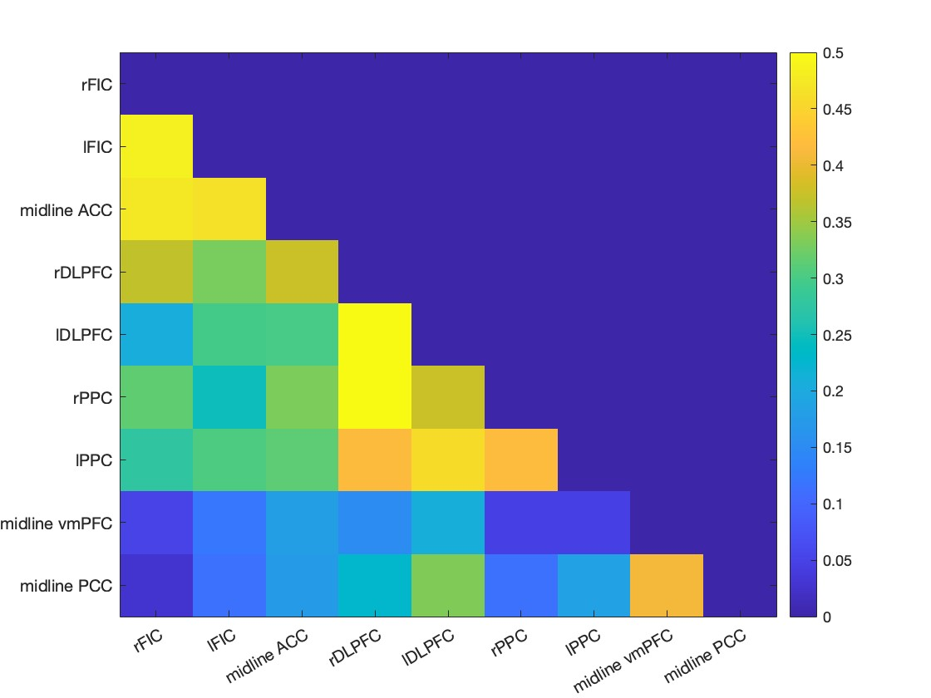
No filtering, detrending, or despiking
After filtering, detrending, or despiking – higher intranetwork correlations
SN
CEN
DMN

